Slide 1


Torchy: A Tracing JIT Compiler for
Nuno P. Lopes
University of Lisbon (IST-UL) & INESC-ID

Slide 2
Computing demand for ML is exploding
FLOPS doubling
every 3.4 months!
2012 2013 2014 2015 2016 2017 2018

Slide 3
ML models run in frameworks
First generation
Developer assembles model as a data-flow graph first
Hard for development & debugging
No support for dynamic models
TensorFlow 1
Second generation / aka eager-mode or imperative
Instructions executed straight away
Easier
PyTorch, TensorFlow 2

Slide 4
Eager-mode frameworks are amazing!
x = torch.tensor(((1.,2.), (3.,4.))) y = torch.tensor(((5.,6.), (7.,8.)))
z = x.mul(y) z = z.add(y) x.add_(z)
print(x)
tensor([[11., 20.],
[31., 44.]])

Slide 5
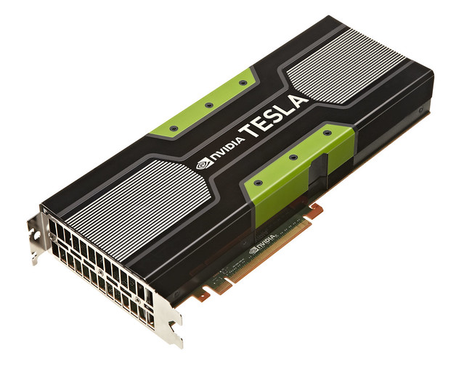

Eager-mode frameworks are slow! 🙄
x = torch.tensor(((1.,2.), (3.,4.))) y = torch.tensor(((5.,6.), (7.,8.)))
z = x.mul(y) z = z.add(y) x.add_(z)
print(x)
tensor([[ 5., 12.],
[21., 32.]])
tensor([[10., 18.],
[28., 40.]])
tensor([[11., 20.],
[31., 44.]])
tensor([[11., 20.],
[31., 44.]])

Slide 6

Is PyTorch inherently inefficient?

Slide 7
Torchy
A Tracing JIT Compiler for PyTorch

Slide 8
Most Tensors are not observed
w = x.mul(y) w = w.add(y) w.add_(x)
print(w)
Tensors are only observed:
Data access, e.g., for branching on data-dependent models
Printing
Some PyTorch functions query layout, size, etc for pre-dispatch optimization (a hack)
Function from 2 tensors to another tensor
Intermediate values of w not observed

Slide 9
Idea: delay execution until observation
x = torch.tensor(((1.,2.), (3.,4.))) y = torch.tensor(((5.,6.), (7.,8.)))
w = x.mul(y) w = w.add(y) x.add_(w)
print(x)
Tracing JIT Compiler
w0 = x.mul(y)
w1 = w0.add(y)
x1 = x.add_(w1)
tensor([[11., 20.],
[31., 44.]])
Observable event! Stop tracing and compute

Slide 10
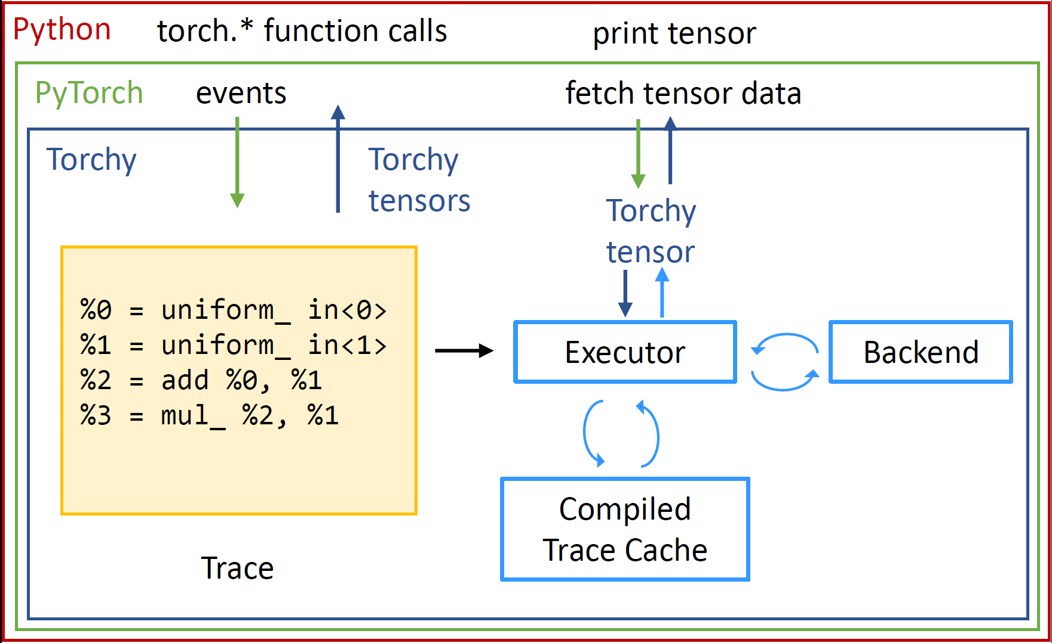
Torchy

Slide 11
Intercepting PyTorch function calls
z = x.add(y)
Waterfall dispatcher
Dispatch:
Operation = Add.Tensor
Op0 = Tensor, CPU, Float
Op1 = Tensor, CPU, Float
Global dispatcher state:
Default device = CPU
Default type = Float
Include dispatch key = Torchy
VMap
Batched
Autocast
Tracer
Torchy
Autograd
Backend Select
Trace
z = add(x, y)
Devices (CPU, CUDA, etc)
import torchy
torchy.enable()

Slide 12
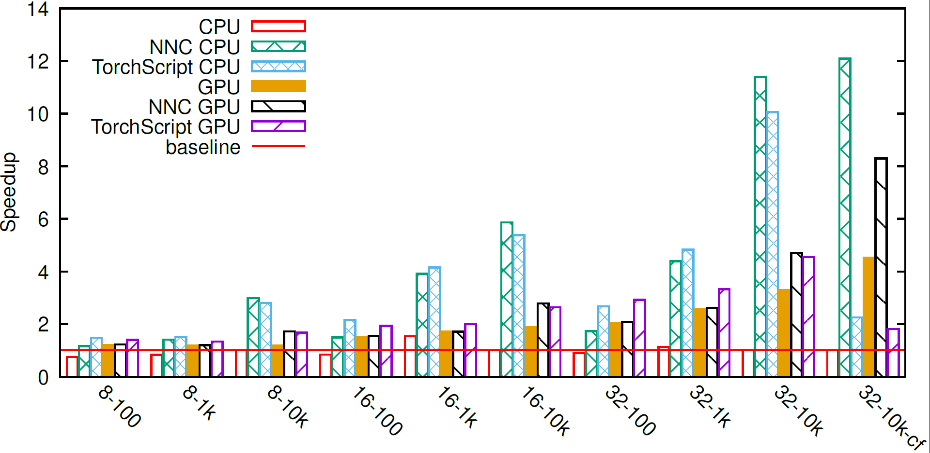
Microbenchmarks
Code with 8, 16, 32 elementwise operations
Square matrices, n=100, 1k, 10k
Straight-line code & with control-flow

Slide 13
Experiments with Standard Models
Run 1,000 inference queries over:
TorchVision: ResNet-18, ResNeXt, MobileNet v3 Large
Hungging Face: Bert Base/Large, GPT-2, RoBERTa Large
PyTorch 1.9+
12 CPU cores

Slide 14
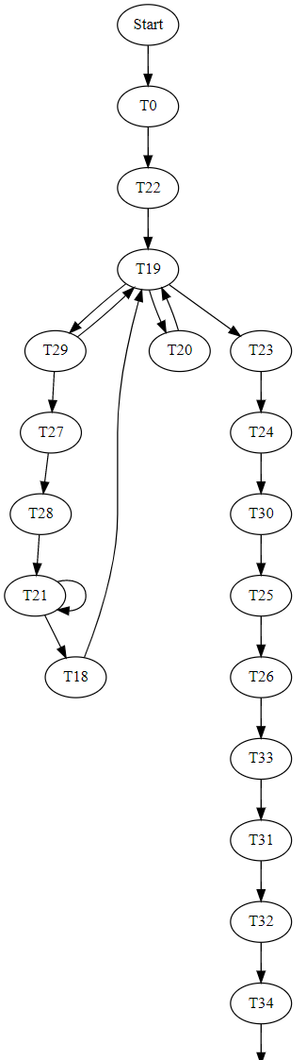
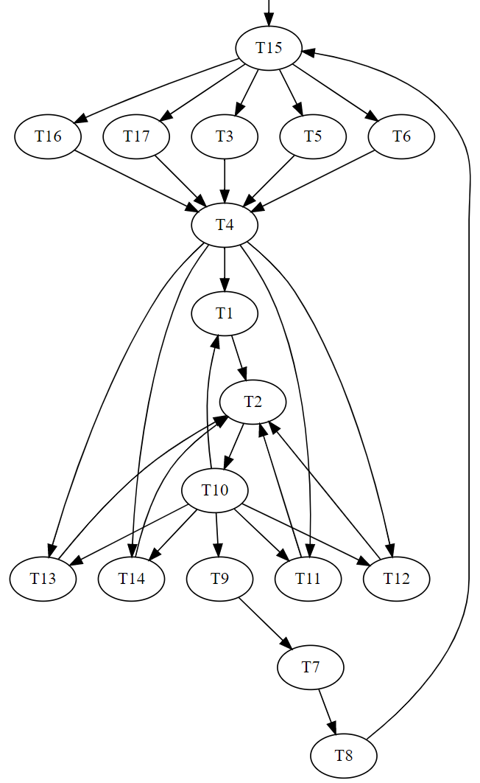
Bert from the compiler’s perspective
Weight initialization
Model

Slide 15
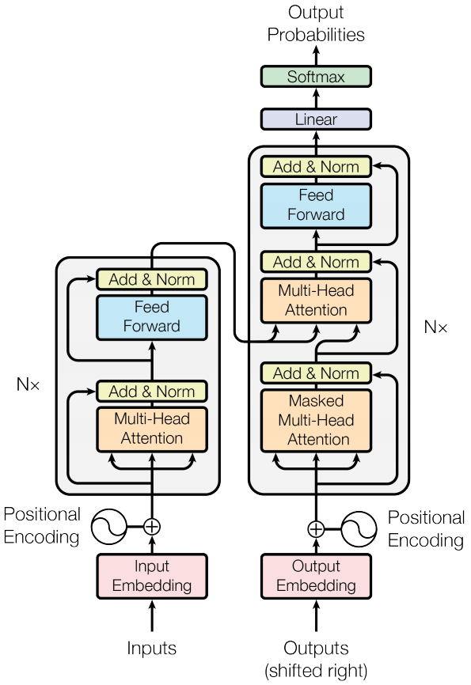
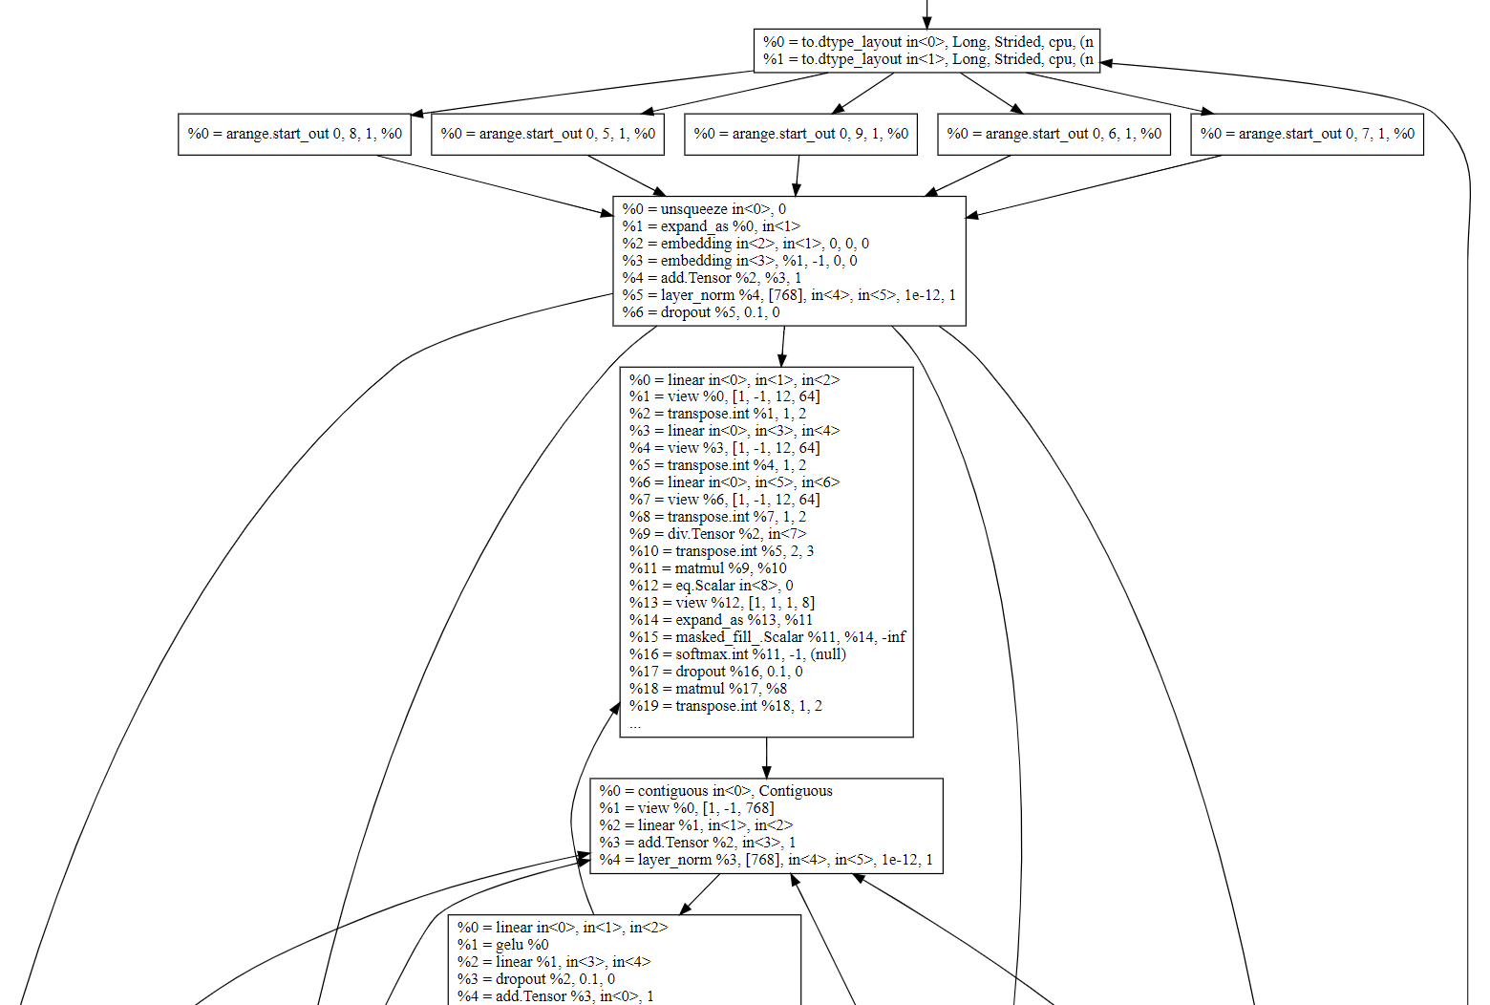
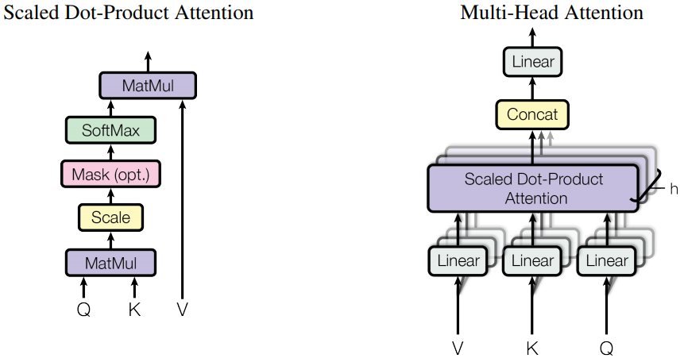
Embedding
Attention Head
Normalization
Feed Forward

Slide 16
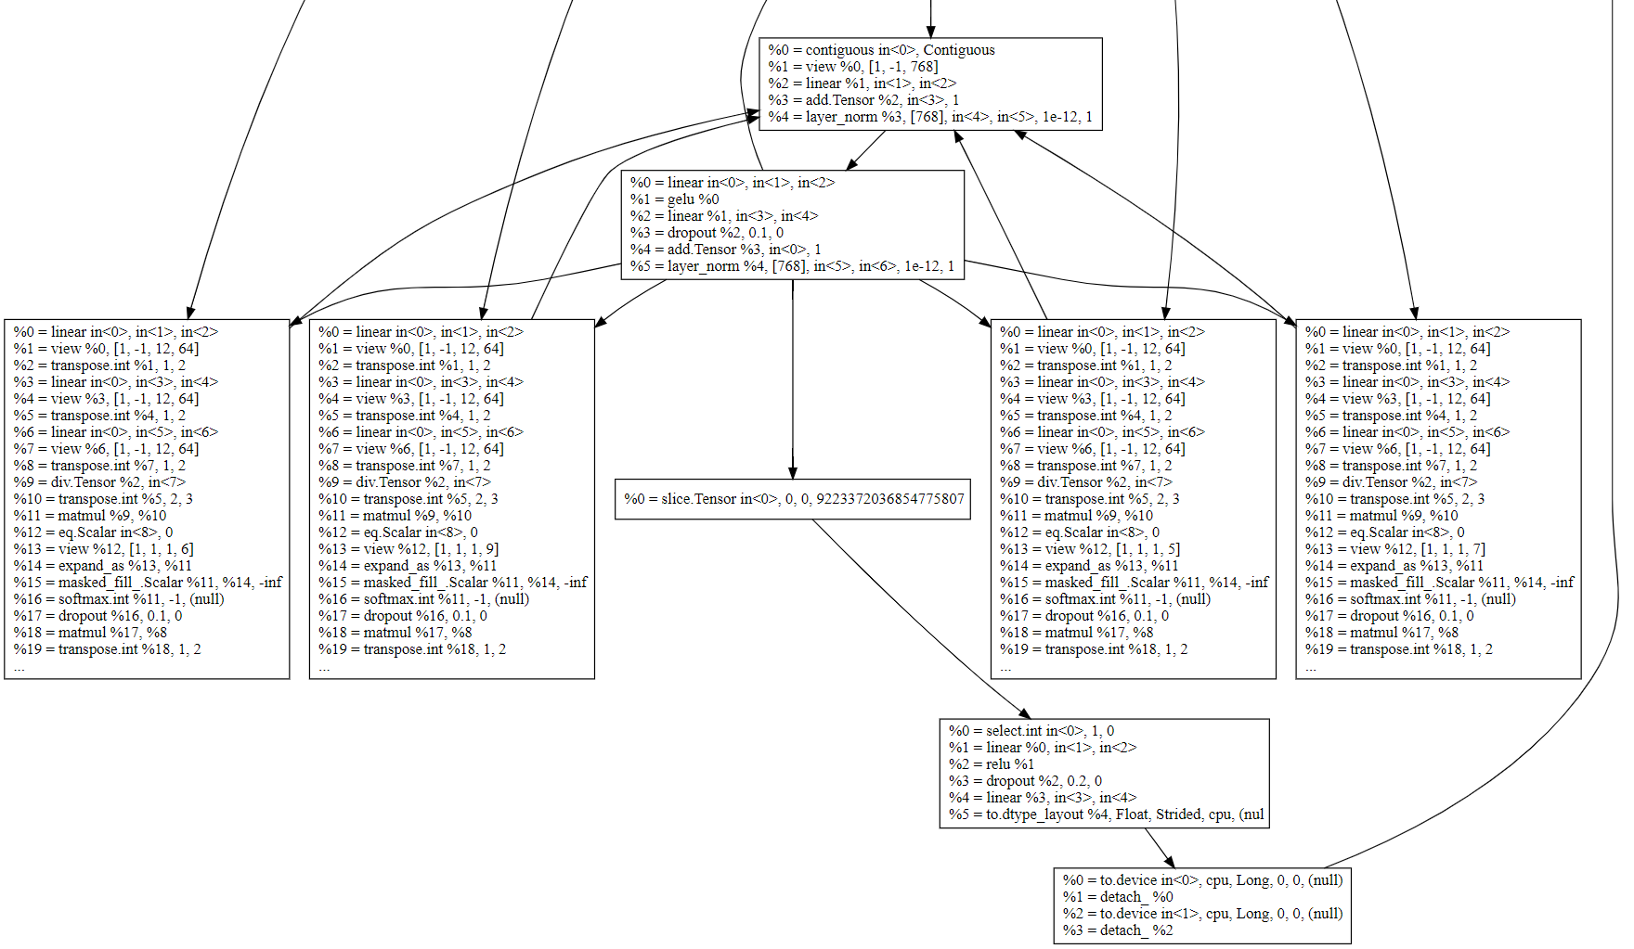
Normalization
Feedforward
Attention
Output result

Slide 17
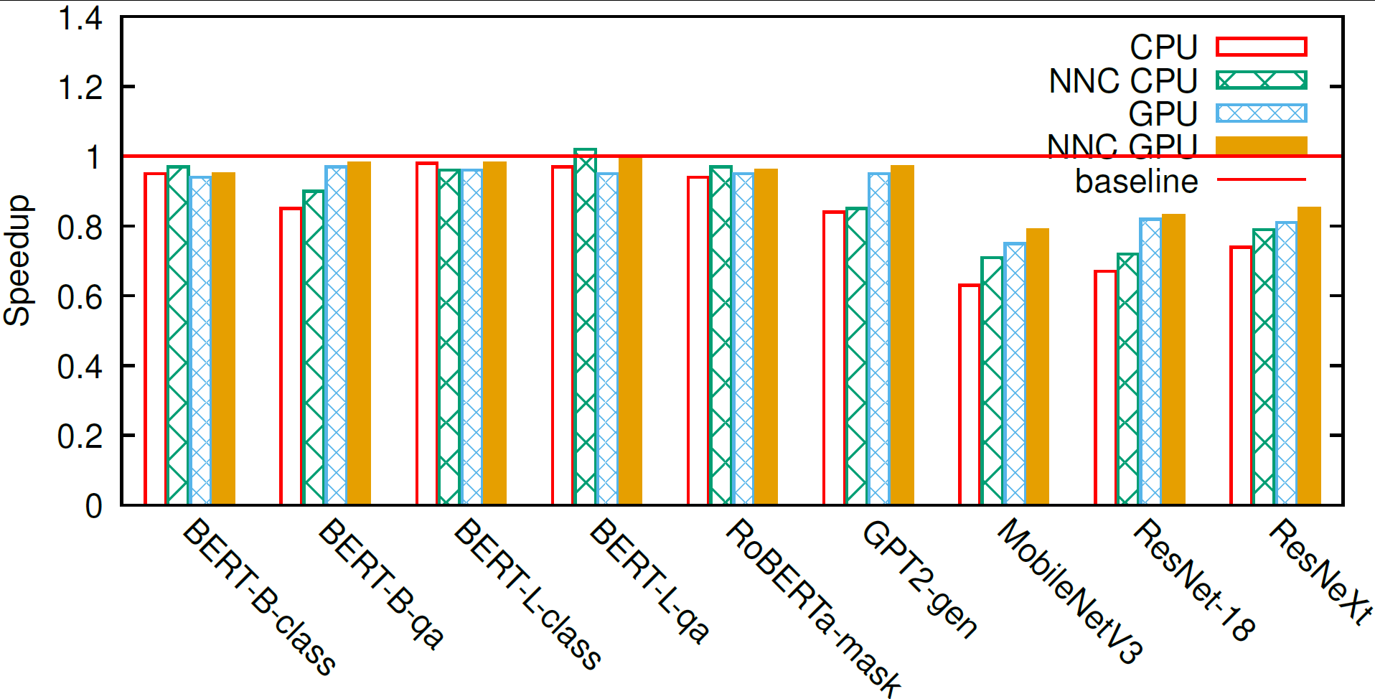
Early Results

Slide 18
Summary: Torchy
Acceleration for dynamic PyTorch programs through JIT compilation
Converts programs into small-ish straight-line programs (traces)
Optimizes and runs each trace with the best backend
Zero code changes! Just run ‘pip install’

Slide 19
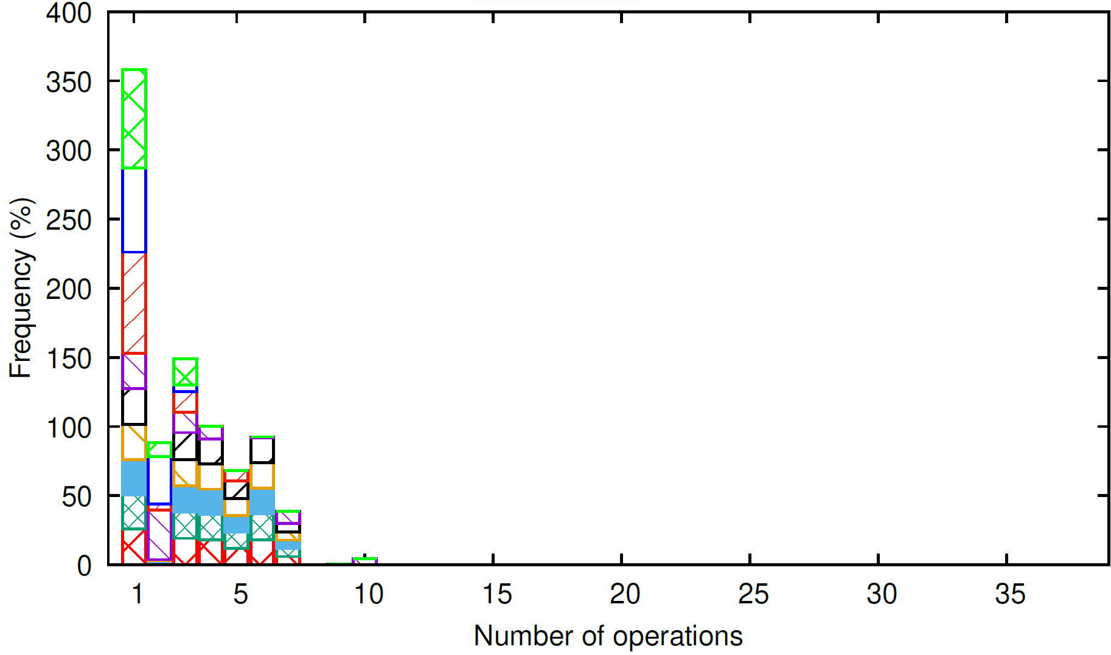
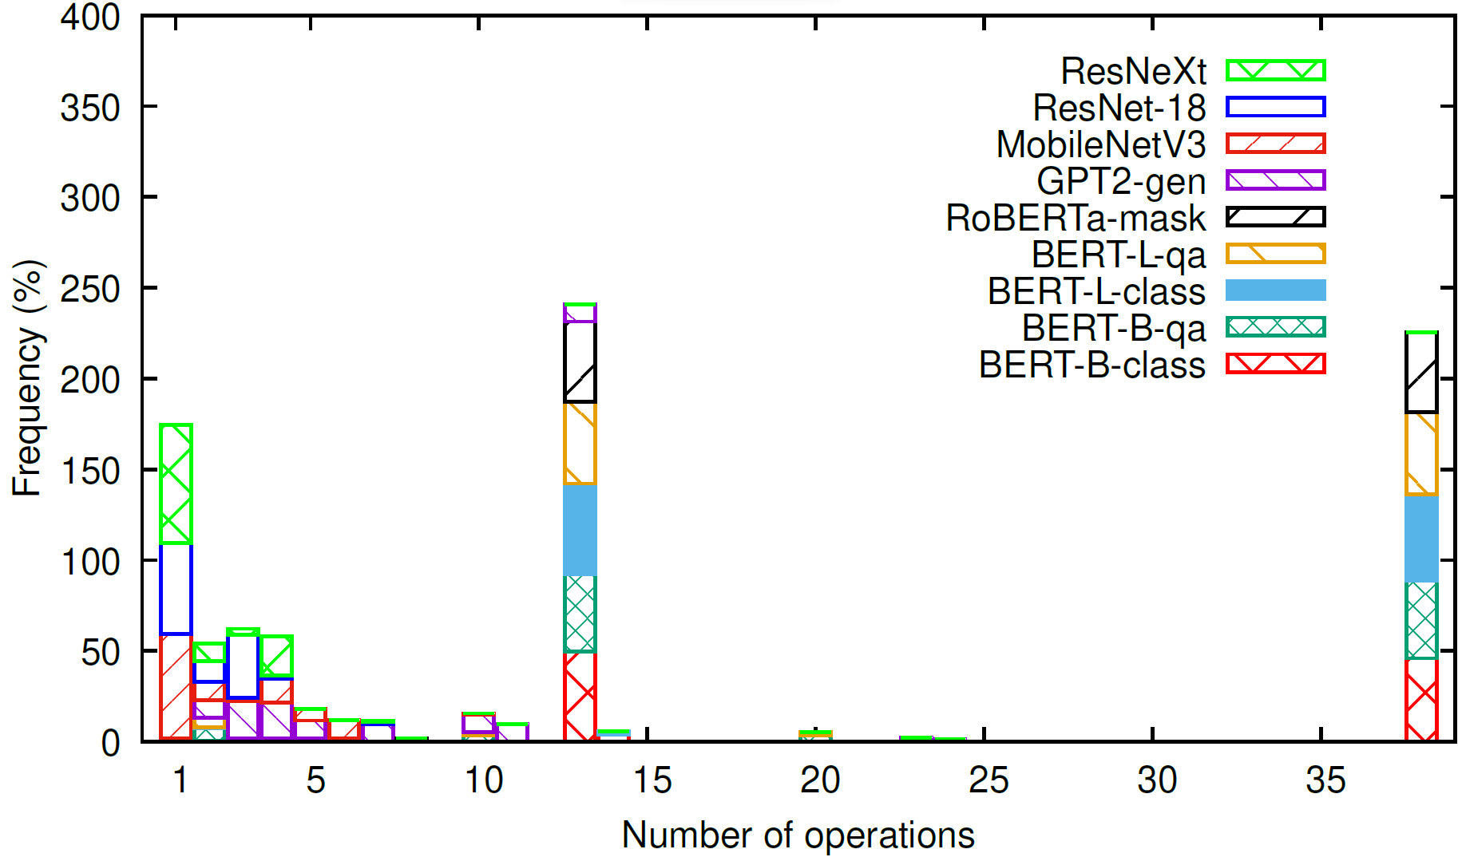
Trace sizes
Without shape inference
With shape inference (partial)

Slide 20
Tracing JIT compilers
A tremendous success for JavaScript in the past decade
Peek into the future as execution is delayed
Detect which tensors are temporaries to help optimization
Traces can be optimized before execution, or in background
Traces repeat; optimization cost amortized
Work with any codebase unmodified!

Slide 21
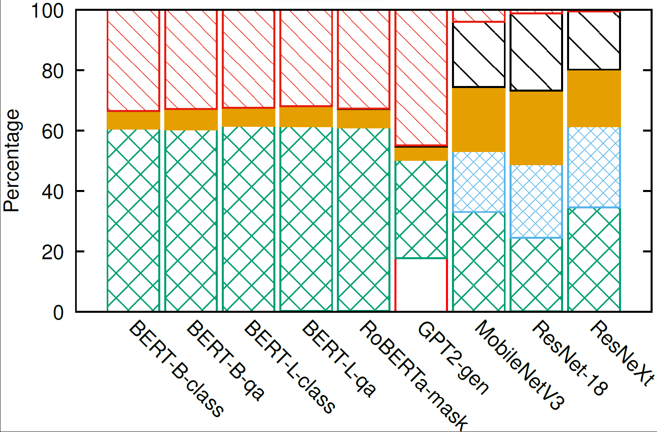
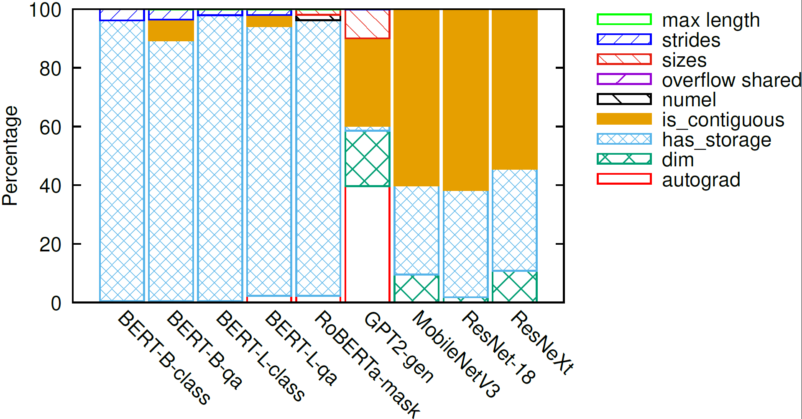
Flush Reasons
Without shape inference
With shape inference (partial)

Slide 22
How many traces?
Model | Unique Traces wo/ inference | With Shape Inference
BERT Base | 87 | 33
BERT Large | 87 | 33
RoBERTa Large | 87 | 42
GPT-2 | 246 | 138
ResNet-18 | 1048 | 1035
ResNeXt | 1065 | 1050
MobileNet v3 large | 1124 | 1098

Slide 23
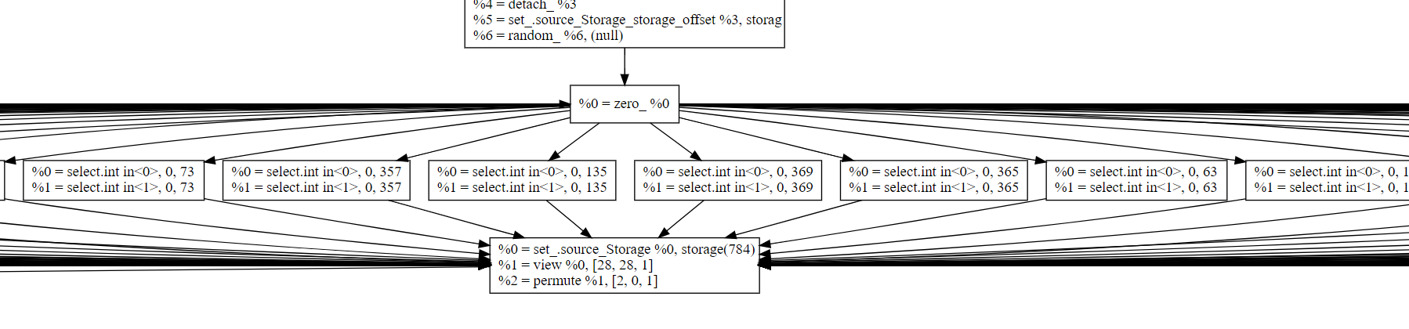
ResNet trace explosion

Slide 24
Life of a PyTorch function call
z = x.add(y)
Waterfall dispatcher
Dispatch:
Operation = Add.Tensor
Op0 = Tensor, CPU, Float
Op1 = Tensor, CPU, Float
Global dispatcher state:
Default device = CPU
Default type = Float
Include dispatch key = None
VMap
Batched
Autocast
Tracer
Autograd
Backend Select
Devices (CPU, CUDA, etc)

Slide 25
What’s a Tensor?
Multiple tensor implementations:
Dense
Sparse
Batched
…
Python Tensor
PyTorch Tensor
Ref counted
TensorImpl
Storage
Ref counted
StorageImpl
Interpretation of the data (aka view)
The data
Other Languages
pybind / C Python API
PyTorch C++’14 code

Slide 26
Tensor creation
Python Tensor
PyTorch Tensor
Ref counted
TensorImpl
Storage
Ref counted
StorageImpl
New Tensor/TensorImpl/Storage/StorageImpl w/ default type & placed on default device
x = torch.tensor(((1.,2.), (3.,4.))) y = torch.tensor(((5.,6.), (7.,8.)))
z = x.mul(y) x.add_(z)
w = x.to(torch.float, copy=False)
z = x.transpose(0, 1)
New Tensor/TensorImpl/Storage/StorageImpl w/ same type & device as inputs
Nothing new; override StorageImpl’s data
Bump Tensor ref count if types match; new Tensor/Storage otherwise
New Tensor/TensorImpl; bump Storage ref count

Slide 27
TorchScript Compilation
Compiler from Python AST to an SSA-based IR (the same used by tracing)
Supports functions with control-flow
But no support for too many Python features (only tensor inputs, no lambdas, no union types, etc, etc) – by design!
Many real codebases are too pythonic. Will never work with TorchScript!

Slide 28
TorchScript Tracing
Function/module is executed (twice) with concrete inputs & operations recorded
def f(x, y):
z = x.add(y)
z.add_(x)
return x.mul(z)
w = torch.tensor(…)
z = torch.tensor(…)
torch.jit.trace(f, (w, z))
SSA-based IR:
def f(x: Tensor, y: Tensor) -> Tensor:
z = torch.add(x, y, alpha=1)
z0 = torch.add_(z, x, alpha=1)
return torch.mul(x, z0)

Slide 29
Tracing input-dependent code
def RAdam(wd, N_sma, …):
if wd != 0:
p_data_fp32.add_(p_data_fp32, alpha=-wd * lr)
# more conservative since it's an approximated value
if N_sma >= 5:
denom = exp_avg_sq.sqrt().add_(eps)
p_data_fp32.addcdiv_(exp_avg, denom, value=-step_size)
else:
p_data_fp32.add_(exp_avg, alpha=-step_size)
There are 4 possible different traces depending on the input!
But TorchScript Tracing only supports single-trace functions.

Slide 30
Intercepting non-dispatched events
print(x)
x.storage()
x.storage()
Python Tensor
PyTorch Tensor
Torchy Tensor
TensorImpl
Storage
StorageImpl
Is tensor materialized?
- Yes: behave like a normal tensor
- No: flush trace & act normally

Slide 31
Eager-frameworks “hacks”
x = torch.tensor(((1.,2.), (3.,4.)))
z = x.transpose(0, 1)
z[0,0] = 42
print(z) print(x)
tensor([[42., 3.],
[ 2., 4.]])
tensor([[42., 2.],
[ 3., 4.]])
+ ever-increasing list of fused ops that users need to call manually
Transpose fuses marvelously with matmul!

