Slide 1
Weakest Precondition Synthesis for Compiler Optimizations
Nuno Lopes and José Monteiro

Slide 2
Why WP Synthesis for Compiler Optimizations?
Deriving preconditions by hand is hard; WPs are often non-trivial
WPs derived by hand are often wrong!
Weaker preconditions expose more optimization opportunities

Slide 3
Motivation: Compilers are Full of Bugs
Yang, Chen, Eide, Regehr. Finding and Understanding Bugs in C Compilers, PLDI’12:
  79 bugs in GCC (25 P1)
  202 bugs in LLVM
  2 wrong-code bugs in CompCert
32 open P1 bug reports in GCC (as of last week)
403 open wrong-code bug reports in GCC
16 open wrong-code bug reports in LLVM

Slide 4
Verification to the Rescue:
LLVM PR17827
lib/Transforms/InstCombine/InstCombineCompares.cpp
// For a logical right shift, we can fold if the comparison is not
// signed. We can also fold a signed comparison if the shifted mask
// value and the shifted comparison value are not negative.
// These constraints are not obvious, but we can prove that they are
// correct using an SMT solver such as "Z3" :
// http://rise4fun.com/Z3/Tslfh
if (ShiftOpcode == Instruction::AShr) {
// There may be some constraints that make this possible,
// but nothing simple has been discovered yet.
CanFold = false;
}

Slide 5
Outline
Preliminaries
Language of Preconditions
Example
Algorithm
Evaluation: PSyCO

Slide 6
Outline
Preliminaries
Language of Preconditions
Example
Algorithm
Evaluation: PSyCO

Slide 7
Compiler Optimizations
Compiler optimization
  Transformation function
  Precondition
  Profitability heuristic

Slide 8
Loop Unswitching
if B then
  while I < N do
  S₁
  I := I + 1
  else
  while I < N do
  S₂
  I := I + 1
while I < N do
  if B then
  S₁
  else
  S₂
  I := I + 1
→
S₁, S₂ are template statements
B is a template Boolean expression

Slide 9
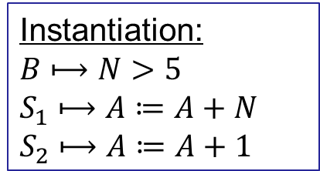
Loop Unswitching:
Example Instantiation
…
while I < N do
  if N > 5 then
  A := A + N
  else
  A := A + 1
  I := I + 1
…
if N > 5 then
  while I < N do
  A := A + N
  I := I + 1
  else
  while I < N do
  A := A + 1
  I := I + 1
while I < N do
  if B then
  S₁
  else
  S₂
  I := I + 1
→
Instantiation:
$$B⟼N>5$$
$$S_{1}⟼A≔A+N$$
$$S_{2}⟼A≔A+1$$

Slide 10
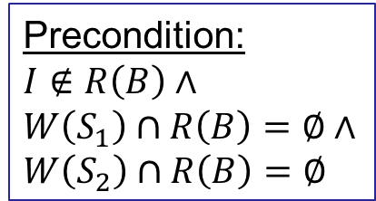
Loop Unswitching:
Weakest Precondition
if B then
  while I < N do
  S₁
  I := I + 1
  else
  while I < N do
  S₂
  I := I + 1
while I < N do
  if B then
  S₁
  else
  S₂
  I := I + 1
→
Precondition:
$$I∉R\left(B\right)∧$$
$$W\left(S_{1}\right)∩R\left(B\right)=∅∧$$
$$W\left(S_{2}\right)∩R\left(B\right)=∅$$

Slide 11
Outline
Preliminaries
Language of Preconditions
Example
Algorithm
Evaluation: PSyCO

Slide 12
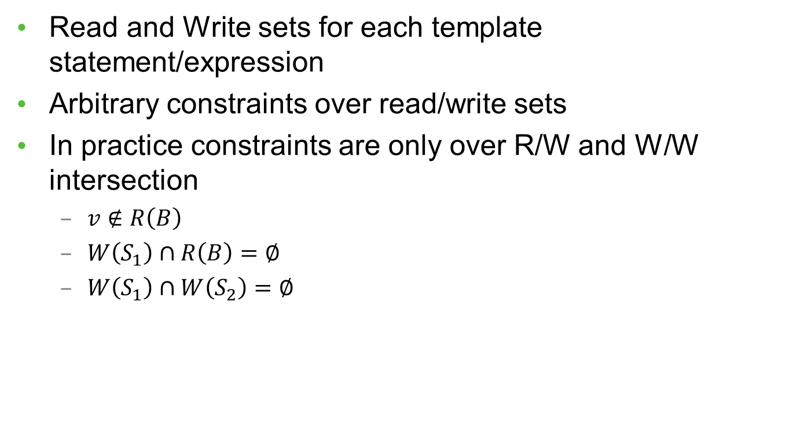
Language of Preconditions
Read and Write sets for each template statement/expression
Arbitrary constraints over read/write sets
In practice constraints are only over R/W and W/W intersection
  $v∉R\left(B\right)$
  $W\left(S_{1}\right)∩R\left(B\right)=∅$
  $W\left(S_{1}\right)∩W\left(S_{2}\right)=∅$

Slide 13
Language of Preconditions:
Suitability
Books and developers already informally speak about read and write sets
Can be efficiently discharged using current compiler technology:
  Memory dependence analysis
  Alias/pointer analysis
  Loop analysis
  Range analysis
  …
Notes:
Language similar to PEC’s (previous work).
It’s not sufficient for all cases (e.g., lacks arith, arith rules).

Slide 14
Outline
Preliminaries
Language of Preconditions
Example
Algorithm
Evaluation: PSyCO

Slide 15
Synthesizing WP for Loop Unswitching
if B then
  while I < N do
  S₁
  I := I + 1
  else
  while I < N do
  S₂
  I := I + 1
while I < N do
  if B then
  S₁
  else
  S₂
  I := I + 1
→

Slide 16
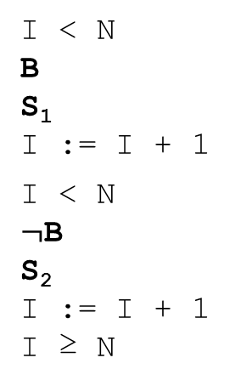
1) Find counterexample
while I < N do
  if B then
  S₁
  else
  S₂
  I := I + 1
if B then
  while I < N do
  S₁
  I := I + 1
  else
  while I < N do
  S₂
  I := I + 1
Pre = true
→
I < N
B
S₁
  I := I + 1
  I < N
  $¬$B
  S₂
  I := I + 1
  I ≥ N
B
I < N
S₁
  I := I + 1
  I < N
  S₁
  I := I + 1
  I ≥ N

Slide 17

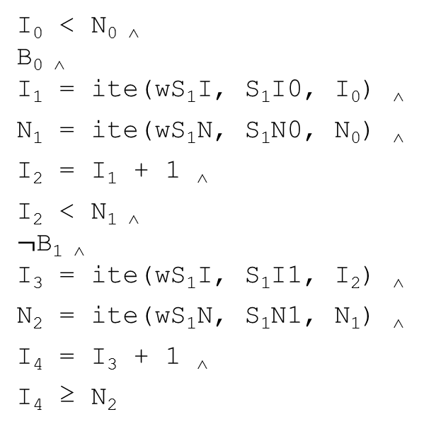
2) Synthesize WP for counterexample:
VC Gen
I < N
B
S₁
  I := I + 1
  I < N
  $¬$B
  S₂
  I := I + 1
  I ≥ N
I₀ < N_{0 ˄}
B_{0 ˄}
  I₁ = ite(wS₁I, S₁I0, I₀) ˄
  N₁ = ite(wS₁N, S₁N0, N₀) ˄
  I₂ = I₁ + 1 ˄
  I₂ < N_{1 ˄}
  $¬$B_{1 ˄}
  I₃ = ite(wS₁I, S₁I1, I₂) ˄
  N₂ = ite(wS₁N, S₁N1, N₁) ˄
  I₄ = I₃ + 1 ˄
  I₄ ≥ N₂
Notes:
WP gen as constraint solving.

Slide 18

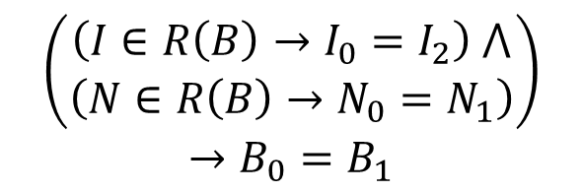
2) Synthesize WP for counterexample:
Conditional Ackermannization
I₀ < N_{0 ˄}
B_{0 ˄}
  I₁ = ite(wS₁I, S₁I0, I₀) ˄
  N₁ = ite(wS₁N, S₁N0, N₀) ˄
  I₂ = I₁ + 1 ˄
  I₂ < N_{1 ˄}
  $¬$B_{1 ˄}
  I₃ = ite(wS₁I, S₁I1, I₂) ˄
  N₂ = ite(wS₁N, S₁N1, N₁) ˄
  I₄ = I₃ + 1 ˄
  I₄ ≥ N₂
B₀ and B₁ are equal if the values of the variables in R(B) are equal
$$\left(\begin{aligned}\left(I∈R\left(B\right)→I_{0}=I_{2}\right) ⋀ \\ \left(N∈R\left(B\right)→N_{0}=N_{1}\right)\end{aligned}\right)$$
$$→B_{0}=B_{1}$$
Notes:
Set membership encoded as Boolean vars.
If read set is empty, then B0=B1 (i.e, it’s a constant).
Similar for Statements.

Slide 19

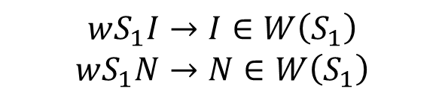
2) Synthesize WP for counterexample:
Must-write vs may-write
I₀ < N_{0 ˄}
B_{0 ˄}
  I₁ = ite(wS₁I, S₁I0, I₀) ˄
  N₁ = ite(wS₁N, S₁N0, N₀) ˄
  I₂ = I₁ + 1 ˄
  I₂ < N_{1 ˄}
  $¬$B_{1 ˄}
  I₃ = ite(wS₁I, S₁I1, I₂) ˄
  N₂ = ite(wS₁N, S₁N1, N₁) ˄
  I₄ = I₃ + 1 ˄
  I₄ ≥ N₂
If a variable is in the write set of a statement, it may or may not be written.
$$wS_{1}I→I∈W\left(S_{1}\right)$$
$$wS_{1}N→N∈W\left(S_{1}\right)$$

Slide 20
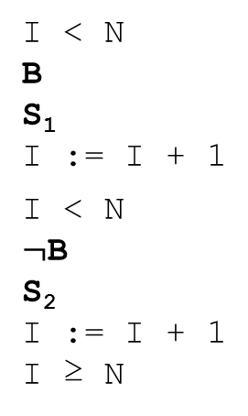
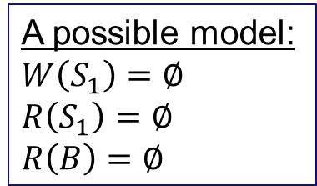
2) Synthesize WP for counterexample:
Final constraint
I < N
B
S₁
  I := I + 1
  I < N
  $¬$B
  S₂
  I := I + 1
  I ≥ N
B
I < N
S₁
  I := I + 1
  I < N
  S₁
  I := I + 1
  I ≥ N
$$∃S ∀V Path ∧Ackermann ∧MustWrite ∧ …→PathIsCorrect$$
A possible model:
$$W\left(S_{1}\right)=∅$$
$$R\left(S_{1}\right)=∅$$
$$R\left(B\right)=∅$$
S = Read/Write sets
V = Vars from VCGen, Must-write vars
Notes:
Not a very interesting model, though.

Slide 21
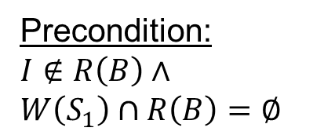
2) Synthesize WP for counterexample:
Disjunction of all models
I < N
B
S₁
  I := I + 1
  I < N
  $¬$B
  S₂
  I := I + 1
  I ≥ N
B
I < N
S₁
  I := I + 1
  I < N
  S₁
  I := I + 1
  I ≥ N
Precondition:
$$I∉R\left(B\right)∧$$
$$W\left(S_{1}\right)∩R\left(B\right)=∅$$

Slide 22
3) Iterate until no more counterexamples can be found
if B then
  while I < N do
  S₁
  I := I + 1
  else
  while I < N do
  S₂
  I := I + 1
while I < N do
  if B then
  S₁
  else
  S₂
  I := I + 1
→
Precondition:
$$I∉R\left(B\right)∧$$
$$W\left(S_{1}\right)∩R\left(B\right)=∅∧$$
$$W\left(S_{2}\right)∩R\left(B\right)=∅$$

Slide 23
Outline
Preliminaries
Language of Preconditions
Example
Algorithm
Evaluation: PSyCO

Slide 24
Algorithm
1) Find counterexample
2) Generate WP that rules out the counterexample
3) Iterate until no more counterexamples can be found

Slide 25
Optimizations
Model generalization
Exploit UNSAT cores
Bias towards R/W and W/W intersections

Slide 26
Outline
Preliminaries
Language of Preconditions
Example
Algorithm
Evaluation: PSyCO

Slide 27
PSyCO: Precondition Synthesizer for Compiler Optimizations
About 1,400 lines of Python
Uses Z3 for constraint solving
Source code and benchmarks available from http://goo.gl/7K02H9

Slide 28
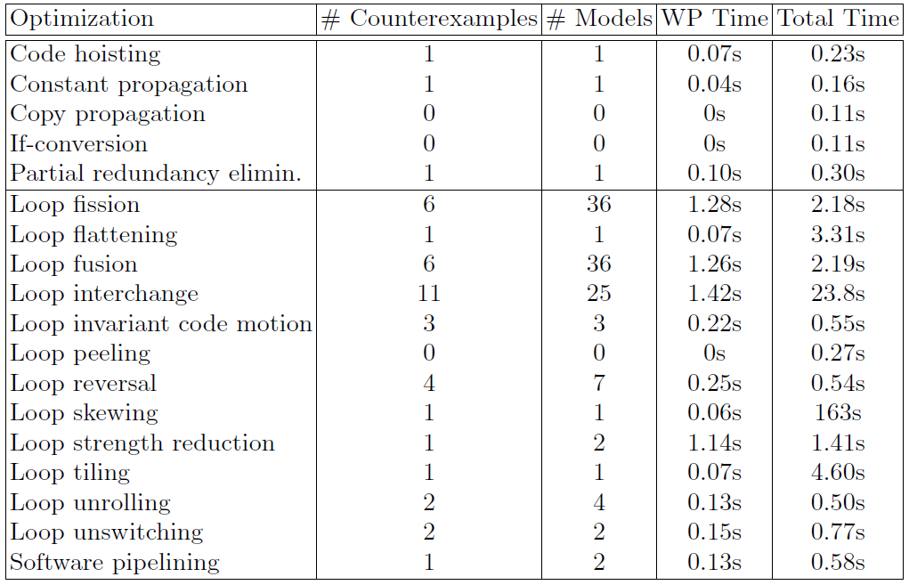
PSyCO: Results

Slide 29
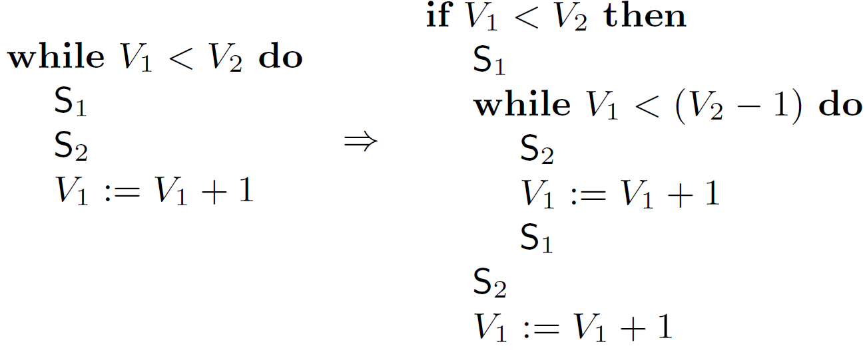
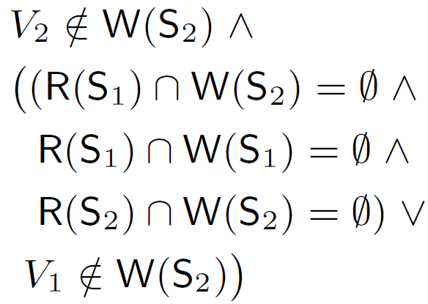
Example of Synthesized WP:
Software Pipelining
Precondition:
(Weaker than PEC’s [PLDI’09])

Slide 30
Conclusion
Deriving WPs by hand is hard and error-prone
Weaker preconditions enable more optimization opportunities
Presented the first algorithm for the automatic synthesis of WPs for compiler optimizations

Slide 31


technology
from seed

