Slide 1
Automatic Synthesis of Weakest Preconditions for Compiler Optimizations
Nuno Lopes
Advisor: José Monteiro

Slide 2

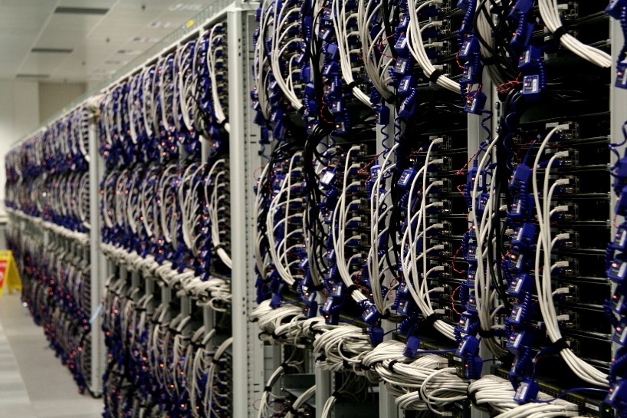
Expectations for Compilers
Improve performance
Reduce code size
Reduce energy consumption
Notes:
And warnings, and debug info.

Slide 3
Compilers Do Deliver
LLVM 3.2 introduced a Loop Vectorizer
Performance improvement of 10-300% in benchmarks
Notes:
Released in 12/2012.

Slide 4
But Compilers are Full of Bugs
Yang, Chen, Eide, Regehr [PLDI’12]:
  79 bugs in GCC (25 P1)
  202 bugs in LLVM
  2 wrong-code bugs in CompCert
Le, Afshari, Su [PLDI’14]:
  40 wrong-code bugs in GCC
  42 wrong-code bugs in LLVM
Last week:
  395 open wrong-code bug reports in GCC
  14 open wrong-code bug reports in LLVM

Slide 5
Churn in Compiler’s code
+0.5M LoC added to LLVM last year
20k commits
Over 4M LoC in LLVM
Notes:
LLVM & clang.

Slide 6
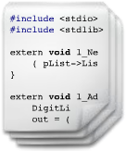
Compilers by Dragon’s Lenses
Frontend
Optimizers
Backend
100101010
010001011
100110101
101010111
001010110

Slide 7
Loop Unswitching
if B then
  while I < N do
  S₁
  I := I + 1
  else
  while I < N do
  S₂
  I := I + 1
while I < N do
  if B then
  S₁
  else
  S₂
  I := I + 1
→
S₁, S₂ are template statements
B is a template Boolean expression

Slide 8
Specifying Compiler Optimizations
Transformation function
Precondition
Profitability heuristic

Slide 9
Contributions
Automatic weakest precondition synthesis for compiler optimizations
Automatic partial equivalence checking, applied to compiler optimization verification

Slide 10
Why WP Synthesis for Compiler Optimizations?
Deriving preconditions by hand is hard; WPs are often non-trivial
WPs derived by hand are often wrong!
Weaker preconditions expose more optimization opportunities

Slide 11
Verification to the Rescue:
LLVM PR17827
lib/Transforms/InstCombine/InstCombineCompares.cpp
// For a logical right shift, we can fold if the comparison is not
// signed. We can also fold a signed comparison if the shifted mask
// value and the shifted comparison value are not negative.
// These constraints are not obvious, but we can prove that they are
// correct using an SMT solver such as "Z3" :
// http://rise4fun.com/Z3/Tslfh
if (ShiftOpcode == Instruction::AShr) {
// There may be some constraints that make this possible,
// but nothing simple has been discovered yet.
CanFold = false;
}
Notes:
Follows code to implement checking of precondition.

Slide 12
Loop Unswitching
if B then
  while I < N do
  S₁
  I := I + 1
  else
  while I < N do
  S₂
  I := I + 1
while I < N do
  if B then
  S₁
  else
  S₂
  I := I + 1
→

Slide 13
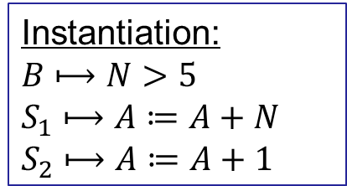
Loop Unswitching:
Example Instantiation
…
while I < N do
  if N > 5 then
  A := A + N
  else
  A := A + 1
  I := I + 1
…
if N > 5 then
  while I < N do
  A := A + N
  I := I + 1
  else
  while I < N do
  A := A + 1
  I := I + 1
while I < N do
  if B then
  S₁
  else
  S₂
  I := I + 1
→
Instantiation:
$$B⟼N>5$$
$$S_{1}⟼A≔A+N$$
$$S_{2}⟼A≔A+1$$

Slide 14
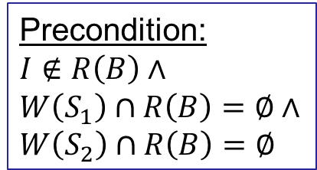
Loop Unswitching:
Weakest Precondition
if B then
  while I < N do
  S₁
  I := I + 1
  else
  while I < N do
  S₂
  I := I + 1
while I < N do
  if B then
  S₁
  else
  S₂
  I := I + 1
→
Precondition:
$$I∉R\left(B\right)∧$$
$$W\left(S_{1}\right)∩R\left(B\right)=∅∧$$
$$W\left(S_{2}\right)∩R\left(B\right)=∅$$

Slide 15
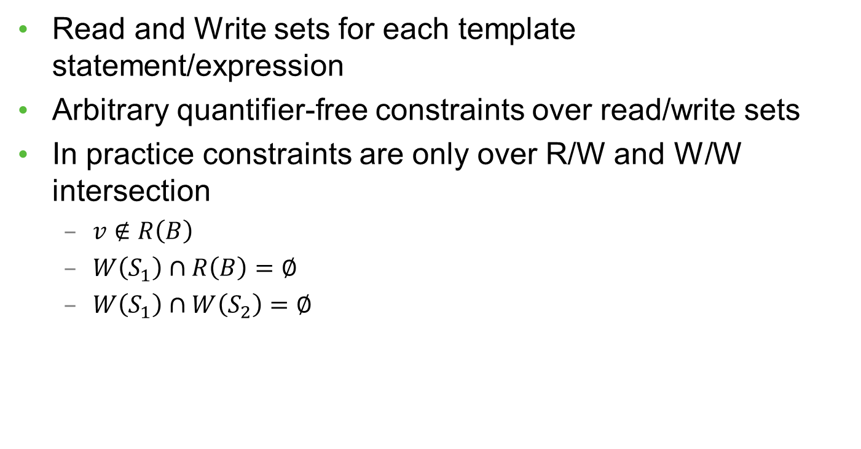
Language of Preconditions
Read and Write sets for each template statement/expression
Arbitrary quantifier-free constraints over read/write sets
In practice constraints are only over R/W and W/W intersection
  $v∉R\left(B\right)$
  $W\left(S_{1}\right)∩R\left(B\right)=∅$
  $W\left(S_{1}\right)∩W\left(S_{2}\right)=∅$

Slide 16
Language of Preconditions:
Suitability
Books and developers already informally speak about read and write sets
Similar to PEC’s
Can be efficiently discharged using current compiler technology:
  Memory dependence analysis
  Alias/pointer analysis
  Loop analysis
  Range analysis
  …
Notes:
It’s not sufficient for all cases (e.g., lacks arith, arith rules).

Slide 17
Synthesizing WP for Loop Unswitching
if B then
  while I < N do
  S₁
  I := I + 1
  else
  while I < N do
  S₂
  I := I + 1
while I < N do
  if B then
  S₁
  else
  S₂
  I := I + 1
→

Slide 18
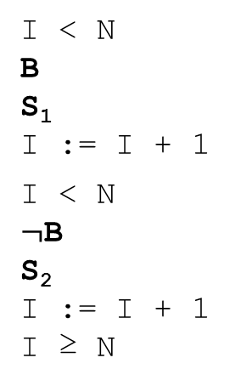
1) Find counterexample
while I < N do
  if B then
  S₁
  else
  S₂
  I := I + 1
if B then
  while I < N do
  S₁
  I := I + 1
  else
  while I < N do
  S₂
  I := I + 1
Pre = true
→
I < N
B
S₁
  I := I + 1
  I < N
  $¬$B
  S₂
  I := I + 1
  I ≥ N
B
I < N
S₁
  I := I + 1
  I < N
  S₁
  I := I + 1
  I ≥ N

Slide 19

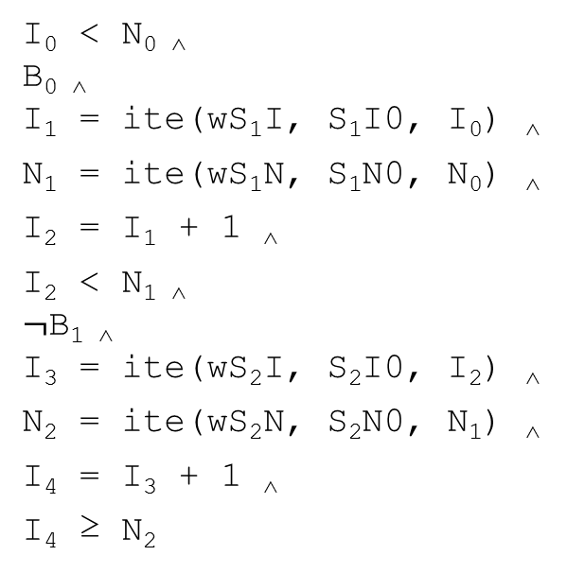
2) Synthesize WP for counterexample:
VC Gen
I < N
B
S₁
  I := I + 1
  I < N
  $¬$B
  S₂
  I := I + 1
  I ≥ N
I₀ < N_{0 ˄}
B_{0 ˄}
  I₁ = ite(wS₁I, S₁I0, I₀) ˄
  N₁ = ite(wS₁N, S₁N0, N₀) ˄
  I₂ = I₁ + 1 ˄
  I₂ < N_{1 ˄}
  $¬$B_{1 ˄}
  I₃ = ite(wS₂I, S₂I0, I₂) ˄
  N₂ = ite(wS₂N, S₂N0, N₁) ˄
  I₄ = I₃ + 1 ˄
  I₄ ≥ N₂
Notes:
WP gen as constraint solving.
Showing VCGen for one program; other is similar.

Slide 20

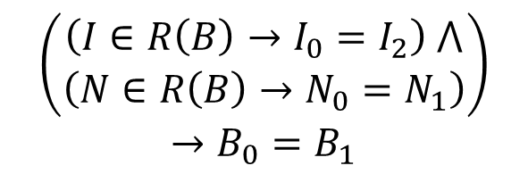
2) Synthesize WP for counterexample:
Conditional Ackermannization
I₀ < N_{0 ˄}
B_{0 ˄}
  I₁ = ite(wS₁I, S₁I0, I₀) ˄
  N₁ = ite(wS₁N, S₁N0, N₀) ˄
  I₂ = I₁ + 1 ˄
  I₂ < N_{1 ˄}
  $¬$B_{1 ˄}
  I₃ = ite(wS₂I, S₂I0, I₂) ˄
  N₂ = ite(wS₂N, S₂N0, N₁) ˄
  I₄ = I₃ + 1 ˄
  I₄ ≥ N₂
B₀ and B₁ are equal if the values of the variables in R(B) are equal
$$\left(\begin{aligned}\left(I∈R\left(B\right)→I_{0}=I_{2}\right) ⋀ \\ \left(N∈R\left(B\right)→N_{0}=N_{1}\right)\end{aligned}\right)$$
$$→B_{0}=B_{1}$$
Notes:
Set membership encoded as Boolean vars.
If read set is empty, then B0=B1 (i.e, it’s a constant).
Similar for Statements.

Slide 21
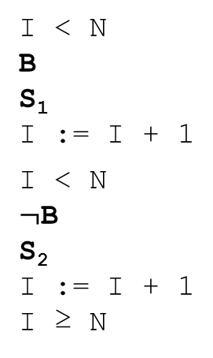
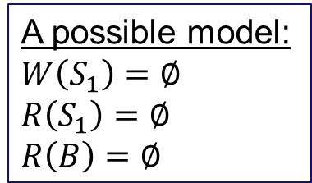
2) Synthesize WP for counterexample:
Final constraint
I < N
B
S₁
  I := I + 1
  I < N
  $¬$B
  S₂
  I := I + 1
  I ≥ N
B
I < N
S₁
  I := I + 1
  I < N
  S₁
  I := I + 1
  I ≥ N
$$∃S ∀V Path ∧Ackermann ∧MustWrite ∧ …→PathIsCorrect$$
A possible model:
$$W\left(S_{1}\right)=∅$$
$$R\left(S_{1}\right)=∅$$
$$R\left(B\right)=∅$$
S = Read/Write sets
V = Vars from VCGen, Must-write vars
Notes:
Not a very interesting model, though.

Slide 22
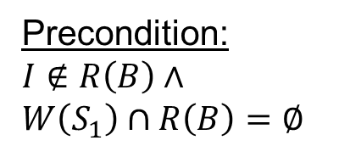
2) Synthesize WP for counterexample:
Disjunction of all models
I < N
B
S₁
  I := I + 1
  I < N
  $¬$B
  S₂
  I := I + 1
  I ≥ N
B
I < N
S₁
  I := I + 1
  I < N
  S₁
  I := I + 1
  I ≥ N
Precondition:
$$I∉R\left(B\right)∧$$
$$W\left(S_{1}\right)∩R\left(B\right)=∅$$

Slide 23
3) Iterate until no more counterexamples can be found
if B then
  while I < N do
  S₁
  I := I + 1
  else
  while I < N do
  S₂
  I := I + 1
while I < N do
  if B then
  S₁
  else
  S₂
  I := I + 1
→
Precondition:
$$I∉R\left(B\right)∧$$
$$W\left(S_{1}\right)∩R\left(B\right)=∅∧$$
$$W\left(S_{2}\right)∩R\left(B\right)=∅$$

Slide 24
Algorithm
1) Find counterexample
2) Generate WP that rules out the counterexample
3) Iterate until no more counterexamples can be found

Slide 25
Optimizations
Model generalization
Exploit UNSAT cores
Bias towards R/W and W/W intersections

Slide 26
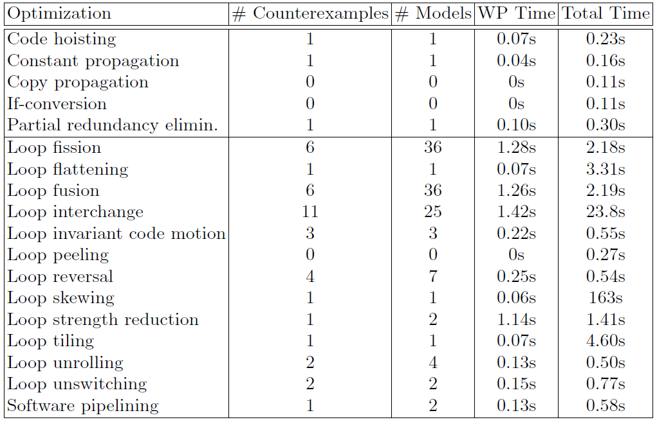
PSyCO: Results
Notes:
Time is not important; run once off-line.

Slide 27
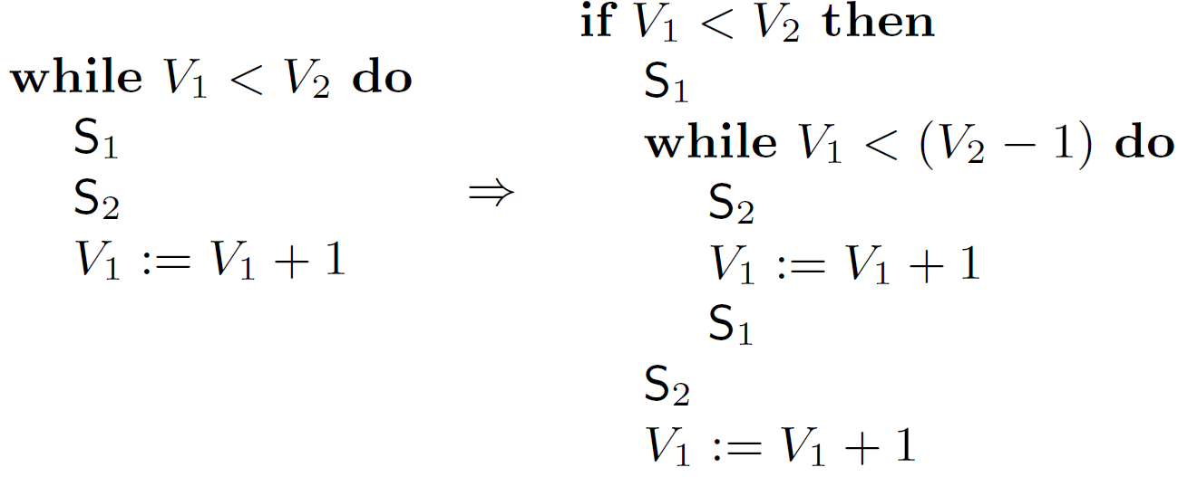
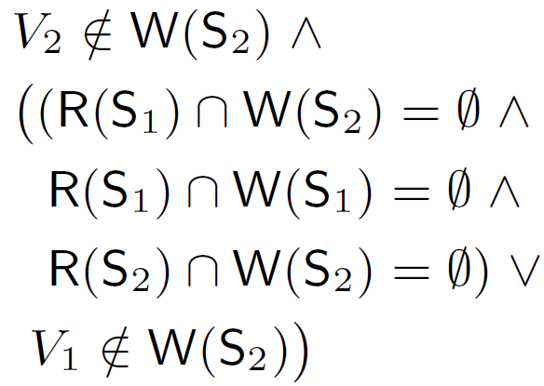
Example of Synthesized WP:
Software Pipelining
Precondition:
(Weaker than PEC’s [PLDI’09])

Slide 28

Verifying Optimizations with CORK
Template statements/expressions become UFs over the read and write sets
  S₁ -> $S_{1}(x,y,z)$ w/ $R\left(S_{1}\right)=\left\{x,y,z\right\}$
Originates 2 UF+IA programs

Slide 29
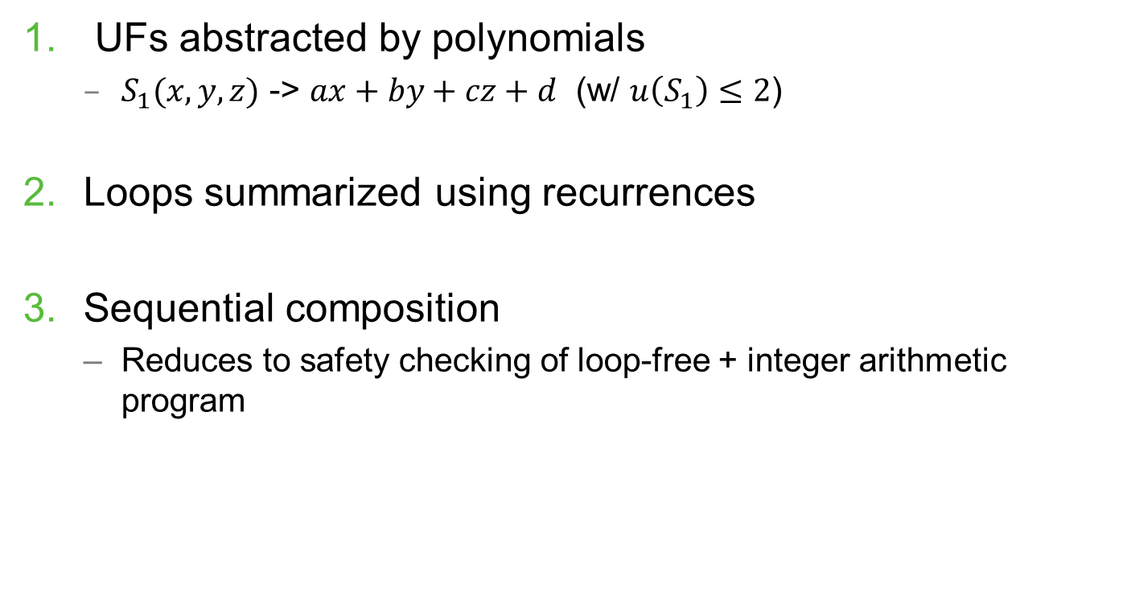
CORK: Partial Equivalence Checking of UF+IA Programs
UFs abstracted by polynomials
  $S_{1}(x,y,z)$ -> $ax+by+cz+d$ (w/ $u\left(S_{1}\right)≤2$)
Loops summarized using recurrences
Sequential composition
  Reduces to safety checking of loop-free + integer arithmetic program

Slide 30
CORK: Polynomial Interpolation

Slide 31
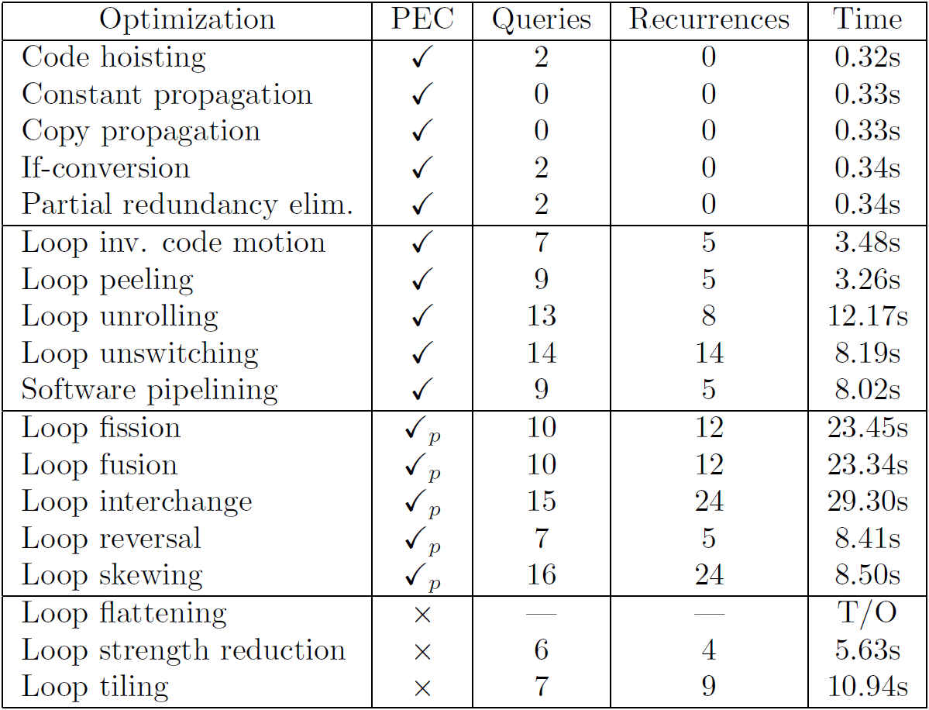
CORK: Results

Slide 32
Future Work
Apply to production compilers
Synthesize implementation of optimizations (pattern matching, VC Gen, code transformation)
Explain reasons for optimization failure
Preserve debug info automatically
Preserve analysis data across optimizations

Slide 33
Conclusion
There is significant on-going effort to improve compilers, which compromises correctness
Presented the first algorithm for the automatic synthesis of WPs for compiler optimizations
Presented the first algorithm for automatic partial equivalence checking of UF+IA programs
  Applied to verification of compiler optimizations

Slide 34


technology
from seed

Slide 35

CORK: UFs -> Polynomials
$f\left(x_{1},…,x_{n}\right)=\sum_{α∙1≤d}{C_{α}X^{α}}$
$u\left(f\right)≤\left({n+d \atop n}\right)$

Slide 36

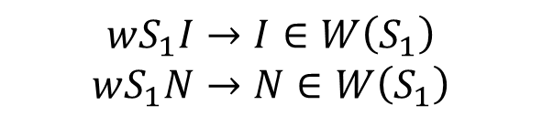
2) Synthesize WP for counterexample:
Must-write vs may-write
I₀ < N_{0 ˄}
B_{0 ˄}
  I₁ = ite(wS₁I, S₁I0, I₀) ˄
  N₁ = ite(wS₁N, S₁N0, N₀) ˄
  I₂ = I₁ + 1 ˄
  I₂ < N_{1 ˄}
  $¬$B_{1 ˄}
  I₃ = ite(wS₂I, S₂I0, I₂) ˄
  N₂ = ite(wS₂N, S₂N0, N₁) ˄
  I₄ = I₃ + 1 ˄
  I₄ ≥ N₂
If a variable is in the write set of a statement, it may or may not be written.
$$wS_{1}I→I∈W\left(S_{1}\right)$$
$$wS_{1}N→N∈W\left(S_{1}\right)$$

Slide 37
Optimizers by Dragon’s Lenses
Analysis 1
Optimization 1
Analysis n
Optimization n
…

Slide 38
An Optimizer from the Future
Analysis 1
Analysis n
…
Pattern Matching
VC Gen
Code Transformer

Slide 39
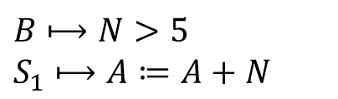
An Optimizer from the Future:
Pattern Matching
Analysis 1
Analysis n
…
Pattern Matching
VC Gen
Code Transformer
…
while I < N do
  if N > 5 then
  A := A + N
  else
  A := A + 1
  I := I + 1
…
  if B then
  S₁
$$B⟼N>5$$
$$S_{1}⟼A≔A+N$$

Slide 40



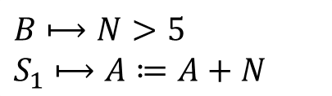
An Optimizer from the Future:
Verification
Analysis 1
Analysis n
…
Range Analysis
Alias Analysis
Scalar Evolution
…
Pattern Matching
VC Gen
Code Transformer
$$B⟼N>5$$
$$S_{1}⟼A≔A+N$$
+ Precondition = φ
Duality
HSF
Terminator
…

Slide 41

An Optimizer from the Future:
Code Transformation
Analysis 1
Analysis n
…
Pattern Matching
VC Gen
Code Transformer
  S₁
  if B then
  skip
  A := A + 1
  if N > 5 then
  skip
  if B then
  S₁
$$B⟼N>5$$
$$S_{1}⟼A≔A+N$$

