Slide 1


Slide 2
Checking Beliefs in Dynamic Networks
Nuno Lopes, Nikolaj Bjørner, Patrice Godefroid, Karthick Jayaraman, George Varghese

Slide 3
Networks
Business critical and complex
Fast protocol deployment in datacenters
A lot of legacy to maintain
Expensive bugs
Frequent protocol changes
Operators don’t have the full picture

Slide 4
Network Verification to the Rescue
Identify bugs
Identify misbeliefs
Increase confidence

Slide 5
This Paper in Context
Implementation bugs (PIC)
E.g., protocol conformance
Routing configuration errors (Batfish)
E.g., router filter error
Dataplane configuration errors (NoD)
E.g., customer VMs can access controller

Slide 6
Existing Work versus Ours
Hassel, Veriflow
Margrave
Network
Optimized
Datalog
(NoD)
Model checkers,
SAT Solvers,
Datalog
NetPlumber
Speed
Expressivity
Notes:
Sweet spot in speed/expressiveness trade-off

Slide 7
Why Expressiveness Matters
Network level
Enables modeling dynamic network behaviors such as new packet headers, new forwarding behaviors, failures, e.g.,
A P4 router adds a new header or a new forwarding behavior
Specification level
Enables higher-level verification queries, e.g.
Customer VMs cannot reach fabric controller
All backup routers are equivalent
Notes:
Both given as input, not backed in the tool.

Slide 8
Example Beliefs
Policy Template | Example
Protection Sets | Customer VMs cannot access controllers
Reachable Sets | Customer VMs can access other VMs
Consistency | ECMP/Backup routes should have identical reachability
Middlebox | Forward path connections through middlebox should reverse
Locality | Packets between two hosts in the same cluster should stay within the cluster

Slide 9
Solution

Slide 10
Network-Optimized Datalog (NoD)
Datalog for the specification of:
Data-plane/control-plane
Verification properties
Tool for efficient verification
Available in open-source SMT solver Z3
Notes:
Both protocol and verification property given as input

Slide 11
Why Datalog?
Good expressiveness/efficiency tradeoff
Supports packet rewriting, load balancing
Provides all (symbolic) solutions for “free”
Unlike SAT solvers or model checkers

Slide 12
Modeling Networks using Datalog
Each matching rule in the FIB and each ACL rule becomes a Datalog rule
State is set of packets at each router
Packets start at sources; Datalog runs to fixed-point -> packets at destinations
Notes:
Encoding matters.

Slide 13
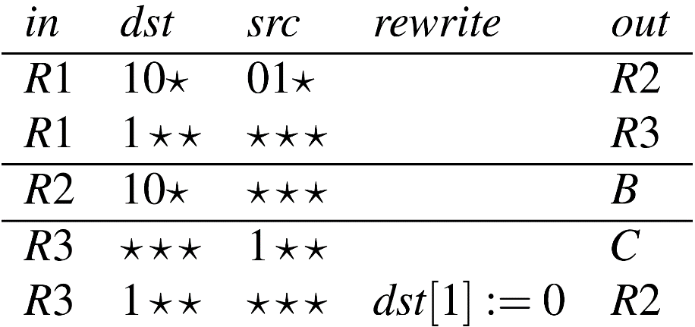
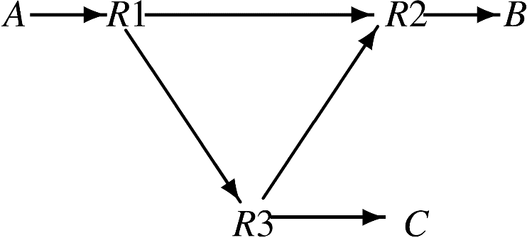
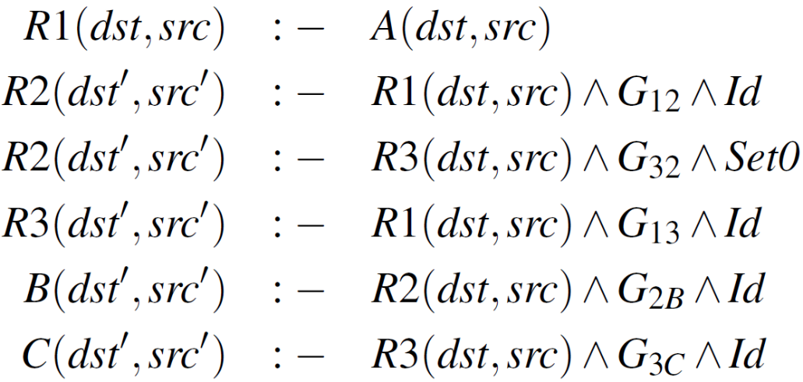
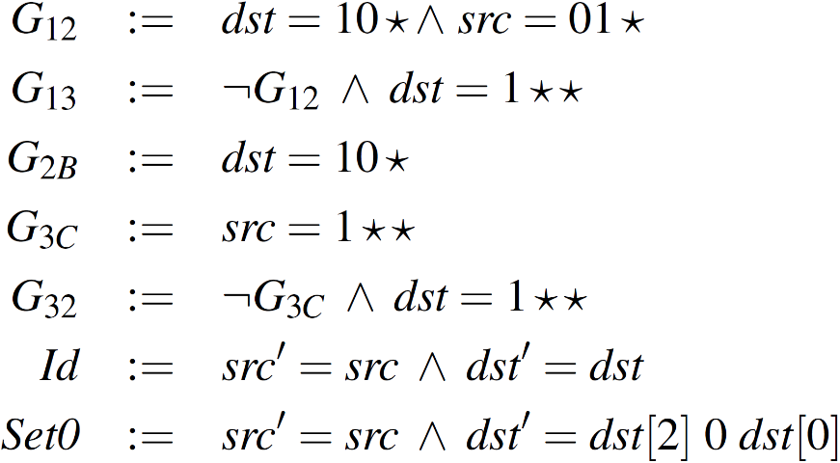
Networks as Datalog Programs
Dataplane
Guards
Notes:
Packets that don’t match any rule are dropped.

Slide 14
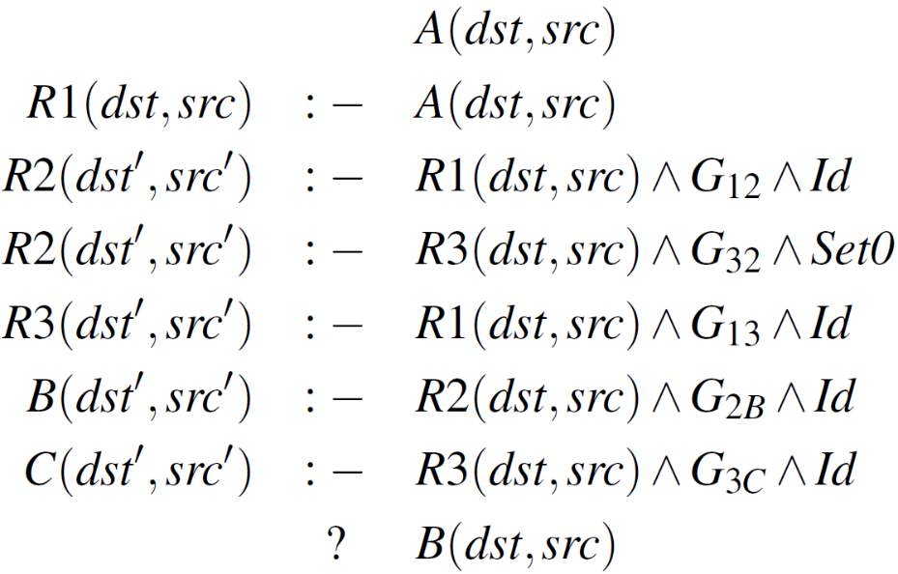


Example of Reachability
Compute all packets sent by A that reach B
Result:
Notes:
Can also compute set of packets reach at B, rather than packets that leave A.

Slide 15
So what’s wrong with Datalog?
Out-of-the-box implementations are slow
They work with a packet a time
Our contributions:
Symbolic representation (dealing with sets of packets)
Efficient propagation of packets across routers

Slide 16
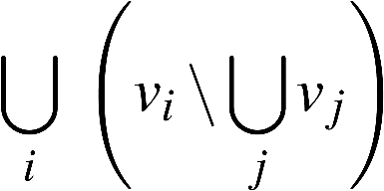

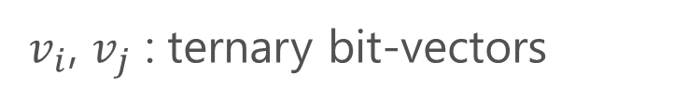
Symbolic Representation
Packets represented as Difference of Cubes [NSDI’12]
Generalized to support negation, useful e.g. to check consistency across backup routers
$v_{i}$, $v_{j}$ : ternary bit-vectors
Examples:
Notes:
Efficient implementation of relation algebra operations.

Slide 17
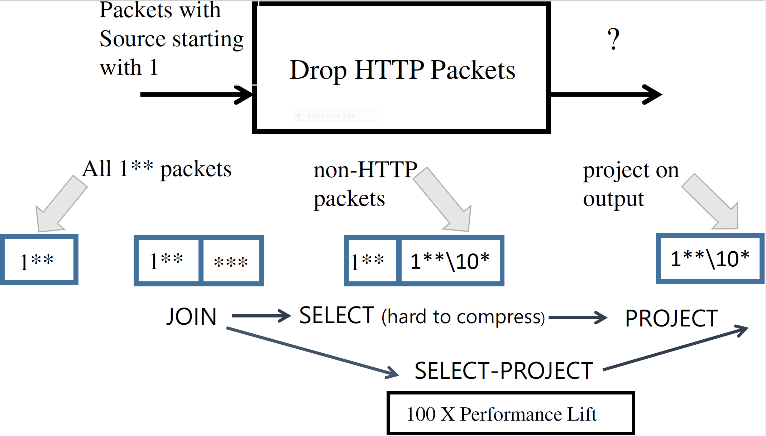
Fuse Internal Datalog Operators
Notes:
Datalog compiled into relation algebra for analysis. Not surprising, since Datalog came from the DB community.
Do not materialize intermediate result.

Slide 18
Evaluation

Slide 19
Evaluation questions
Do beliefs help?
How hard is it to add a new forwarding protocol?
How does NoD performs compared with existing verification tools?
Is this useful in practice?

Slide 20
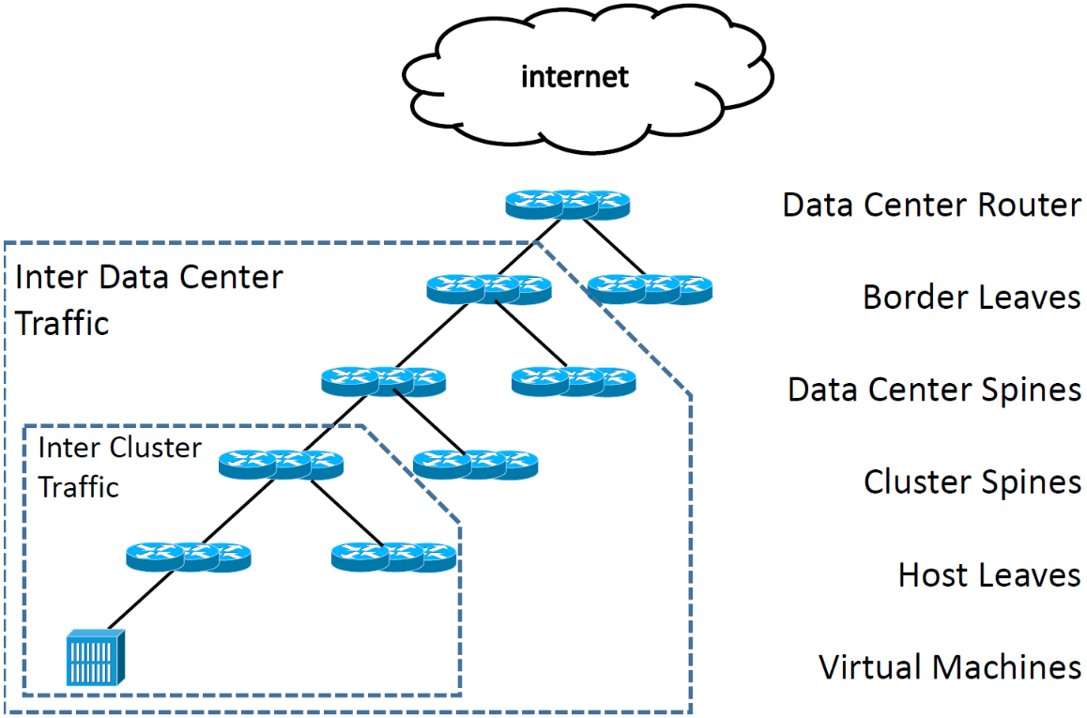
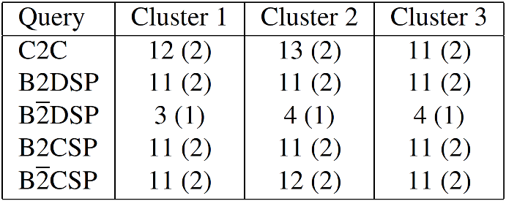
Beyond Reachability: Locality
Found multiple violations of traffic locality
Verification time in seconds
Notes:
Possible caused by miswiring during buildout.

Slide 21
Checking Operators’ Beliefs
Operators cannot specify reachability at VM level for millions of VMs
They have “beliefs” of which sets of stations can reach others
Found exceptions to operator’s beliefs
Customer VMs cannot access fabric controllers
Process of belief refinement helps elicit specifications

Slide 22
Dynamism Example
Experimental MPLS-like backbone with custom forwarding
Took a few hours to model without any tool change
Loop detection in < 1 second
Identified 56 flows as black holes in 5 seconds

Slide 23
Performance Comparison
 | Model Checker | SMT All Solutions | NoD | HSA
Stanford Unreach | 12.2 | 0.1 | 2.1 | 0.1
Stanford Reachable | 13.7 | 1121 | 5.9 | 0.9
Stanford Loop | 11.7 | 290 | 3.9 | 0.2
Cloud | Time out | Time out | 15.7 | -
Cloud 2 | 8.5 | Time out | 4.8 | -
Run time in seconds

Slide 24
Network Verification in Production
Simplified version of NoD: SecGuru
Local checks on each router
Deployed in Azure
Finds ~1 problem per day
Reduced legacy corporate ACL from 3,000 to 1,000 rules without outages

Slide 25
Conclusion
NoD is expressive; takes as input:
Protocol specification -> Dynamism
Verification properties -> Beliefs
More expressive than previous network verification tools, while competitive in speed
Network operators’ beliefs are fragile
Code and benchmarks available on-line!

