Slide 1
Automatic Equivalence Checking of UF+IA Programs
Nuno Lopes and José Monteiro

Slide 2
Why Equivalence Checking?
Algorithm recognition
Regression checking
Manual optimization checking
Compiler optimization verification
Information flow (non-interference) proofs

Slide 3
Example: Are these programs equivalent?
i := 0
while i < n do
k := f(k, i)
i := i + 1
i := n
while i ≥ 1 do
k := f(k, n - i)
i := i - 1
if n ≤ 0 then
i := 0
else
i := n

Slide 4
Example: Sequential composition is no solution
assume v = v i := 0
while i < n do
k := f(k, i)
i := i + 1
i := n
while i ≥ 1 do
k := f(k, n - i)
i := i - 1
if n ≤ 0 then
i := 0
else
i := n
assert v = v

Slide 5
Outline
Program equivalence
Example
Algorithm
Application to compiler optimizations
Evaluation: CORK

Slide 6
Program equivalence
Functional equivalence: non-deterministic behavior is not supported
Partial equivalence: check only terminating paths

Slide 7
Running example
i := 0
while i < n do
k := f(k, i)
i := i + 1
i := n
while i ≥ 1 do
k := f(k, n - i)
i := i - 1
if n ≤ 0 then
i := 0
else
i := n

Slide 8
Running example: 1) Sequential composition
assume v = v i := 0
while i < n do
k := f(k, i)
i := i + 1
i := n
while i ≥ 1 do
k := f(k, n - i)
i := i - 1
if n ≤ 0 then
i := 0
else
i := n
assert v = v

Slide 9
Running example: 2) Eliminate UFs
assume v = v i := 0
while i < n do
k := a·k + b·i + c
i := i + 1
(…)
assert v = v
f(k, i)

Slide 10
Running example: 3) Eliminate Loops
assume v = v i := 0
while i < n do
k := a·k + b·i + c
i := i + 1
(…)
assert v = v
assume v = v i := 0
if i < n then
assume R_{i}(j-1) < n ∧ R_{i}(j) ≥ n
k := R_{k}(j)
i := R_{i}(j)
(…)
assert v = v
R_{i}(j) = R_{i}(j-1) + 1
R_{i}(0) = 0
R_{k}(j) = a × R_{k}(j-1) + b × R_{i}(j-1) + c
R_{k}(0) = k₀
$$R_{i}\left(j\right)=j$$
$$R_{k}\left(j\right)=\frac{b\left(a^{j}−aj+j−1\right)+\left(a−1\right)\left(a^{j}\left(\left(a−1\right)k_{0}+c\right)−c\right)}{{\left(a−1\right)}^{2}}$$

Slide 11
Running example: 3) Eliminate Loops
assume v = v i := 0
if i < n then
assume R_{i}(j-1) < n ∧ R_{i}(j) ≥ n
k := R_{k}(j)
i := R_{i}(j)
i := n
if i ≥ 1 then
assume V_{i}(j-1) ≥ 1 ∧ V_{i}(j) < 1
k := V_{k}(j)
i := V_{i}(j)
if n ≤ 0 then
i := 0
else
i := n
assert v = v

Slide 12
Outline
Program equivalence
Example
Algorithm
Application to compiler optimizations
Evaluation: CORK

Slide 13
Algorithm
Sequential composition
Replace UFs with polynomials
Replace loops with recurrences
Prove safety of resulting program

Slide 14
Algorithm: 1) Sequential Composition
assume v = v
P1(v)
P2(v)
assert v = v

Slide 15
Algorithm: Function u
u(f, i) is equal to the maximum number of applications of f with distinct values in the ith parameter in all paths minus one
if i < n then
k := f(y, 3)
else
k := f(z, 3)
if f(x, 3) < 0 ∧ k < 0 then
…
u(f, 1) = 1
u(f, 2) = 0

Slide 16
Algorithm: Polynomial Interpolation

Slide 17
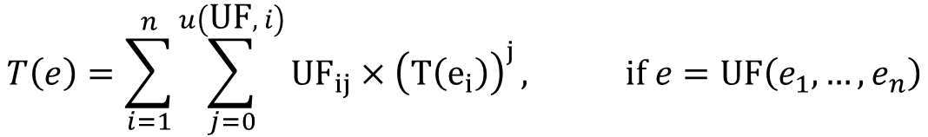
Algorithm: 2) UF -> Polynomial
UFs are rewritten to polynomials over its inputs
$$T\left(e\right)=\sum_{i=1}^{n}{\sum_{j=0}^{u\left(\text{UF}, i\right)}{{{\text{UF}}_{ij}×\left(T\left(e_{i}\right)\right)}^{j}}, \text{if} e=\text{UF}\left(e_{1},…,e_{n}\right)}$$

Slide 18
Algorithm: 3) Loops -> Recurrences
if b then
assume σ_{n-1}(b) ∧ σ_{n}(¬b)
v_{i} := σ_{n}(v_{i})
else
assume n = 0
while b do
c
→

Slide 19
Algorithm: 4) Prove safety of resulting program
Resulting program is correct iff the 2 programs are partially equivalent
Standard model checkers or VC gen + constraint solving can now prove correctness

Slide 20
Outline
Program equivalence
Example
Algorithm
Application to compiler optimizations
Evaluation: CORK

Slide 21
Compiler Optimizations
Compiler optimization
Transformation function
Precondition
Profitability heuristic

Slide 22
Loop Unrolling
while (I + 1) < N do
S
I := I + 1
S
I := I + 1
if I < N then
S
I := I + 1
while I < N do
S
I := I + 1
⇒
Precondition:
R(S) = {I, N, c₁}
W(S) = {c₁}

Slide 23
Loop Unrolling: Example instantiation
while (I + 1) < N do
S
I := I + 1
S
I := I + 1
if I < N then
S
I := I + 1
while (i + 1) < n do
x := i + 2
i := i + 1
x := i + 2
i := i + 1
if i < n then
x := i + 2
i := i + 1
while I < N do
S
I := I + 1
while i < n do
x := i + 2
i := i + 1
⇒
S ≡ x := i + 2 I ≡ i
N ≡ n

Slide 24
Compiler Optimizations: Our abstraction
Transformation function specified as 2 template programs
Precondition specified as read/write sets for template statements and expressions plus IA formulas

Slide 25
Transformation function to UF+IA Program
A transformation function can be written as two UF+IA programs
Template statements are converted to UFs, that read and write from/to their read/write sets
S
→
x,y := S_{x}(y, z), S_{y}(y, z)
Precondition:
R(S) = {y, z}
W(S) = {x, y}

Slide 26
Outline
Program equivalence
Example
Algorithm
Application to compiler optimizations
Evaluation: CORK

Slide 27
CORK: Compiler Optimization Correctness Checker
Implemented in OCaml (~1,100 LoC)
Uses Wolfram Mathematica 8 for constraint and recurrence solving

Slide 28
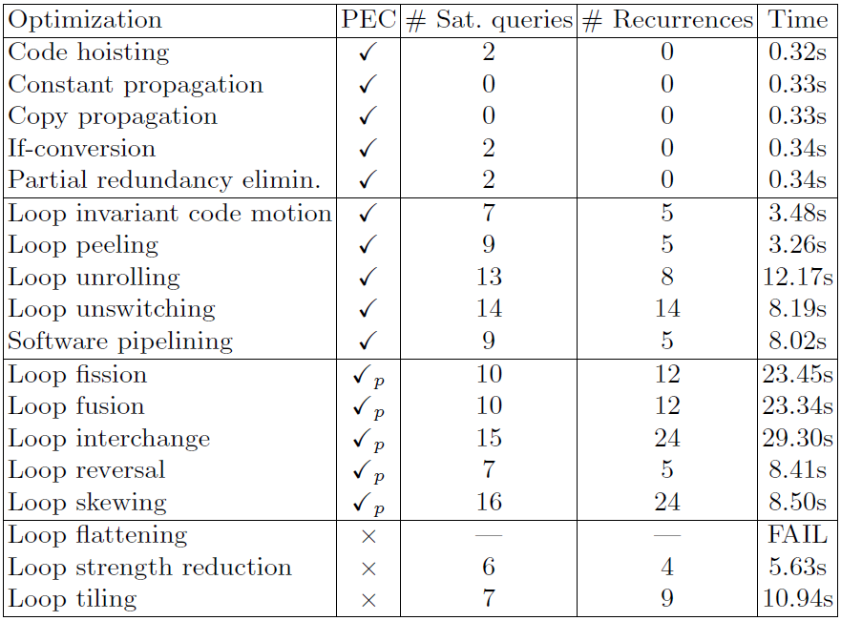
CORK: Results
Benchmarks available from http://web.ist.utl.pt/nuno.lopes/cork/

Slide 29
Conclusion
Presented a new algorithm to prove equivalence of UF+IA programs
Presented CORK, a compiler optimization verifier, that can prove more optimizations correct than others

Slide 30


technology from seed

