Slide 1

Translation Validation for LLVM’s AArch64 Backend
Ryan Berger (Nvidia), Mitch Briles (Utah), Nader Bushehri (Utah), Nicholas Coughlin (Queensland), Kait Lam (Queensland), Nuno Lopes (Lisbon), Stefan Mada (Utah), Tanmay Tirpankar (Utah), John Regehr (Utah)

Slide 2
Typical Compiler
C++
Swift
JavaScript
Rust
Frontends
IR
IR
IR
IR
Optimization 1
IR
…
This talk: Are backends correct?
Optimization n
x86
ARM
PowerPC
Nvidia PTX
Backends

Slide 3
What’s in a Backend?
Historical answer:
Register allocation
Instruction selection
Instruction scheduling
Modern answer is the old stuff +
Dead code elimination
Loop invariant code motion
Algebraic simplifications
Common subexpression elimination
Stack coloring
...

Slide 4
Are Compiler Backends Correct?
🤣
LLVM’s Target and CodeGen directories have > 1M LoC
This much code…
Creates plenty of opportunities for bugs
Is challenging to adequately test

Slide 5
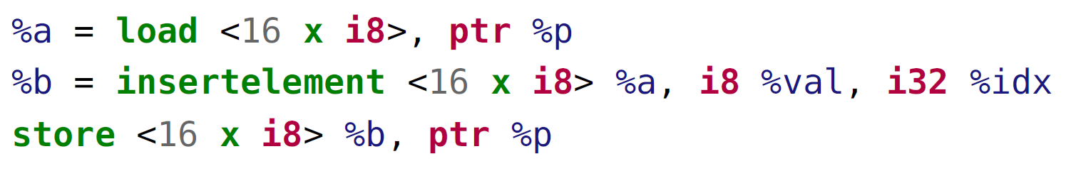
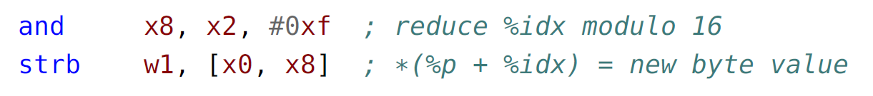
Compiler Bugs = Security Vulnerabilities
Can store anywhere!
“If idx exceeds the length of val for a fixed-length vector, the result is a poison value.” (LLVM IR spec aka LangRef)
✅

Slide 6
Translation Validation (TV) to the Rescue
Proving that a single execution of a compiler is correct
Alive2 successfully productized TV for compiler optimizations
Found hundreds of bugs in LLVM
1,300+ LLVM commits mention Alive2 (to certify the correctness of the commit)
This paper: applying TV for Aarch64 (ARM64) backend

Slide 7

ARM-TV: Lifter + Alive2
AArch64 backend (llc)
assembly
Lifter
LLVM IR
Lifted IR
Optimized Lifted IR
opt -O2
target
source
Does target refine source?

Slide 8
ARM-TV Example
1 define i32 @foo() {
2 br label %1
3 1:
4 %2 = phi i32 [ 1, %0 ], [ %4, %1 ]
5 %3 = phi i8 [ 0, %0 ], [ %5, %1 ]
6 %4 = and i32 %2, 4
7 %5 = add i8 %3, -1
8 %6 = icmp eq i8 %5, 0
9 br i1 %6, label %7, label %1
10 7:
11 ret i32 %4
12 }
1 define i32 @foo() {
2 i8_loop:
3 %X8_0 = zext i32 0 to i64
4 %X0_0 = zext i32 1 to i64
5 br label %.LBB0_1 6 .LBB0_1:
7 %X0_1 = phi i64 [ %X0_0, %i8_loop ], [ %X0_4, %.LBB0_1]
8 %X8_1 = phi i64 [ %X8_0, %i8_loop ], [ %X8_4, %.LBB0_1]
9 %X0_2 = trunc i64 %X0_1 to i32
10 %X0_3 = and i32 %X0_2, 4
11 %X0_4 = zext i32 %X0_3 to i64
12 %X8_2 = trunc i64 %X8_1 to i32
13 %X8_3 = sub i32 %X8_2, 1
14 %X8_4 = zext i32 %X8_3 to i64
15 %Z_0 = trunc i64 %X8_4 to i32
16 %Z_1 = and i32 %Z_0, 255
17 %Z_2 = icmp eq i32 %Z_1, 0
18 %Z_3 = xor i1 %Z_2, 1
19 br i1 %Z_3, label %.LBB0_1, label %i8_loop-tgt1 20 i8_loop-tgt1:
21 %RES = trunc i64 %X0_4 to i32
22 ret i32 %RES
23 }
Is refined by? ⇒
LLVM’s llc
1 foo:
2 mov w8, #0
3 mov w0, #1
4 .LBB0_1:
5 and w0, w0, #0x4
6 sub w8, w8, #1
7 tst w8, #0xff
8 b.ne .LBB0_1
9 ret
ARM-TV lifter

Slide 9
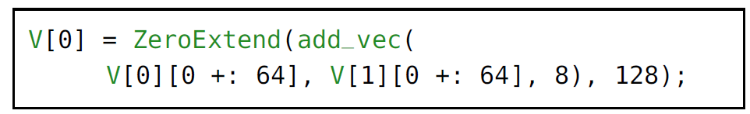
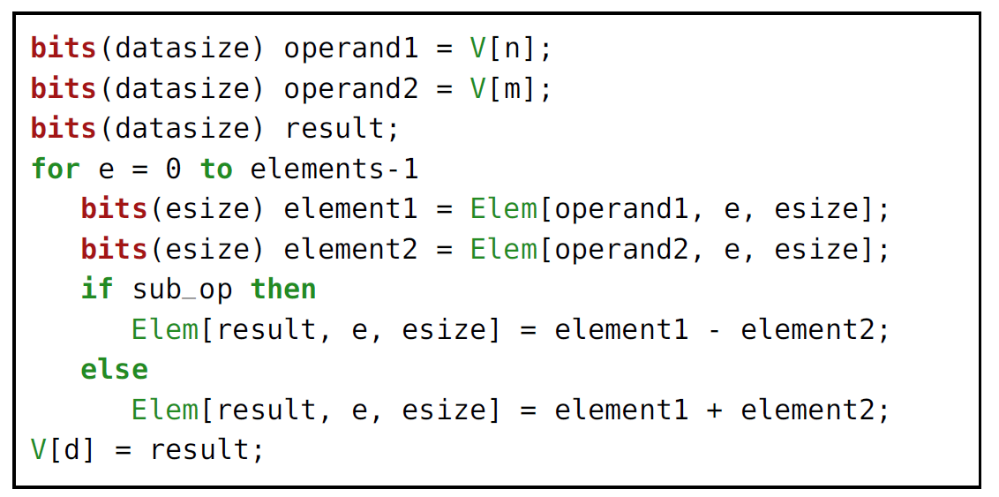
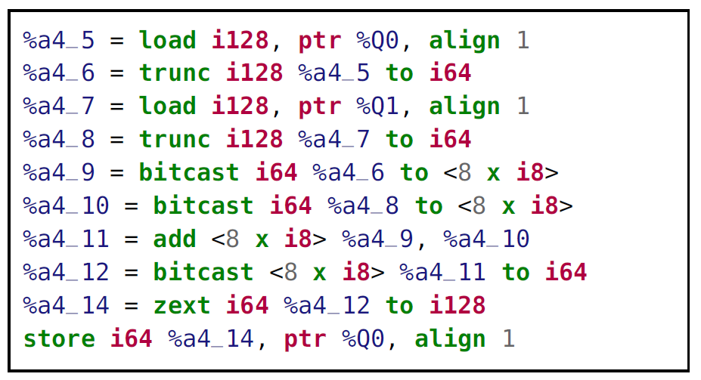

Generating the Lifter w/ Partial Evaluation From ARM Spec
Keep only relevant machine state (e.g., always in user mode)
Reduced ASL
ASL specification

Slide 10
Checking ABI Compliance
Caller and callee saved registers
Sign/zero-extended arguments
Stack alignment
Padding of non-byte-aligned memory accesses

Slide 11
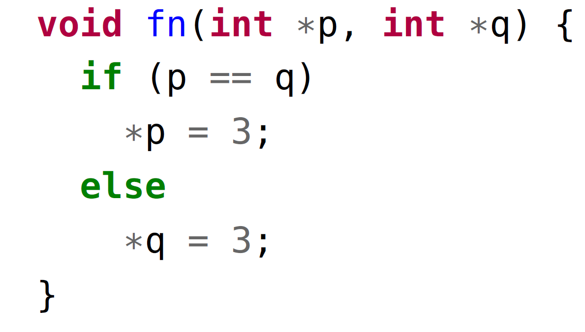
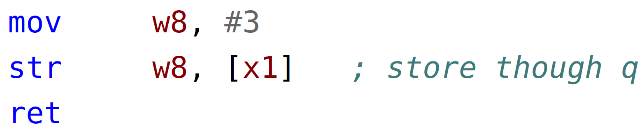
Alive2: Assembly Mode
Lifted LLVM IR is valid, but it is not a refinement of source!
Assembly uses a flat memory model, IR doesn’t

Slide 12
Alive2: Assembly Mode
Extended Alive2 with an assembly mode:
Added flat memory model
Allow source/target to have different memory models
No undef/poison in assembly
A few SMT encoding optimizations

Slide 13
Conclusion
Compilers have bugs
Some introduce security vulnerabilities in compiled programs
Translation validation (TV) is a practical approach to identify bugs in compilers
ARM-TV reuses existing TV framework to find 45 bugs in Aarch64 backend:
Lifts assembly to LLVM IR
Checks ABI compliance
New assembly mode for Alive2
Lifter generated automatically from ARM specification!

