Slide 1

Alive2: Bounded Translation Validation for LLVM
2
Nuno Lopes
Juneyoung Lee, Chung-Kil Hur
Zhengyang Liu, John Regehr
Microsoft Research
Seoul National University
University of Utah
Notes:
Hello!
This talk is about Alive2, our new bounded translation validation tool for LLVM.

Slide 2
Bugs in LLVM
Simple implementation bugs
Complex architectural flaws
What’s the impact of a different semantics? What breaks?
How to guarantee a fix is complete across millions of LoC?
Specification document (LangRef) is huge and not always clear
Impact of compiler bugs is critical (security incl)
Notes:
LLVM, like any other software project, has bugs. These range from simple implementation bugs to architectural flaws. We’ve described some of these complex issues in previous work.
Fixing issues in IR semantics is a very challenging task, as the IR is the data-structure used across the whole compiler. One needs to understand what’s the impact of the change, what breaks, what’s left to fix, and so on.
LLVM’s specification document (usually called LangRef) is huge but still doesn’t cover many of the corner cases, including undefined behaviors. Therefore, this document is open to different interpretations, which leads to bugs.
Furthermore, we are all more aware now of the critical impact of miscompilations. We’ve seen several recent cases of security vulnerabilities caused by compilers.

Slide 3
We need semantics for verification
select %c, %a, %b
 | UB if c poison + conditional poison | UB if c poison + poison if either a/b poison | Conditional poison + non-det choice if c poison | Conditional poison + poison if c poison | Poison if any of a/b/c poison
control-flow → select | ✓ |  | ✓ | ✓
select → control-flow | ✓ | ✓
select → arithmetic |  | ✓ |  |  | ✓
select removal | ✓ | ✓ |  | ✓ | ✓
select hoisting | ✓ | ✓ | ✓
easy movement |  |  | ✓ | ✓ | ✓
Which one is the best and why?
Which one LLVM uses?
Notes:
To do any sort of verification, we need the semantics of LLVM’s IR. Unfortunately, it’s not always clear what the right semantics is. As an example, let’s look at the select instruction, which is similar to the ternary comparison operator found in many languages.
LLVM’s specification document did not specify the behavior around poison values. So we made a table comparing different possible semantics. There were two main questions that we had to answer: what is the best semantics and why? And which one was LLVM using? Without a tool that can automatically check conformance with a given semantics across most optimizations it would be next to impossible to answer these questions. Fortunately, Alive2 is such a tool!
And spoiler alert: different LLVM optimizations were using different semantics, which could off course lead to end-to-end miscompilations.

Slide 4

Simple Integration with LLVM
C, C++,
ObjC,
Rust,
Swift,
…
frontend
llvm2alive
static unroll
encode semantics &
refinement check
LLVM IR
Alive2 IR
Alive2 IR
LLVM middle-end
optimizers
SMT formulas
LLVM IR
Alive2 IR
Alive2 IR
clang, rustc, etc
LLVM
Alive2
UNSAT
or partial model
clang w/ alive2 plugin:
$ alivecc file.c
opt plugin:
$ opt -tv -instcombine -tv file.ll
Notes:
Alive2 integrates straightforwardly with LLVM. First you use the front-end as usual to produce LLVM IR from your favorite language. Then Alive2 snapshots that code. Then we optimize it using LLVM, and again snapshot it. Then, since we do bounded translation validation, Alive2 unrolls loops by a fixed amount.
Finally, Alive2 encodes the semantics of the program before and after optimizations, including all of the undefined behaviors, and encodes the refinement checks as well. These formulas are then discharged automatically using Z3.

Slide 5
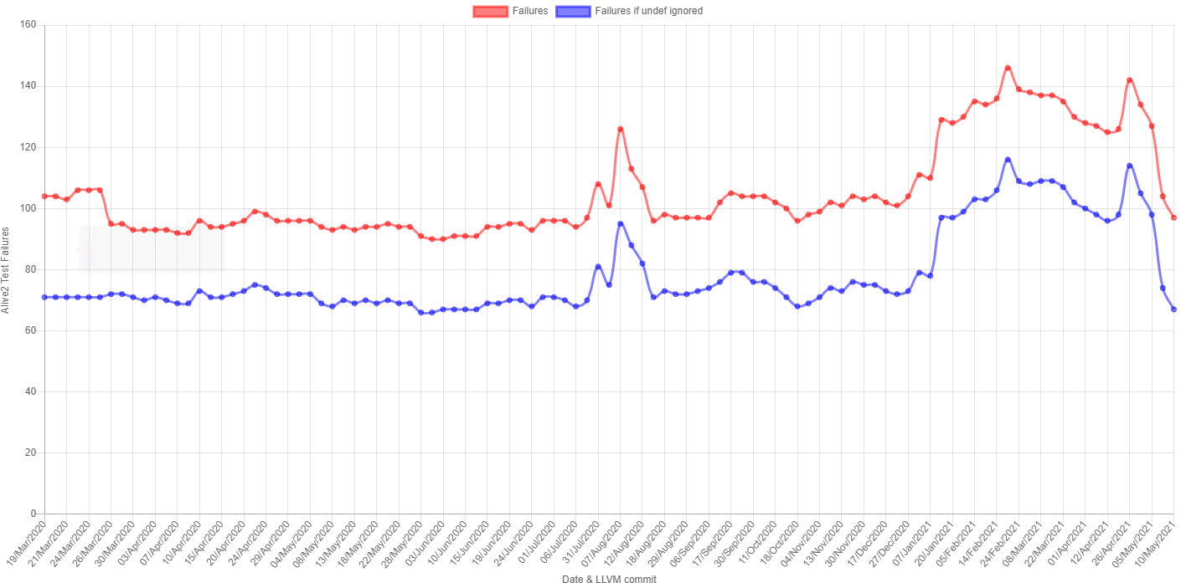
Continuous verification
Alive2 adds support for more LLVM features
Finds new bugs in LLVM; fixed at same pace
LLVM adds new unit tests
for select issues
Fix SimplifyCFG bug
Fix long-standing
InstCombine bug re
select instruction
Fix regression in Alive2
when passing null
pointers as arguments to
function calls
Notes:
For the past year we’ve been running Alive2 continuously on LLVM’s test suite to identify bugs.
In the beginning, we can observe a lot of churn. Every time we would add support for another LLVM feature, we would find some bug, either in the implementation, or in the specification. Bugs in LLVM were being fixed at about at the same pace that we were implementing features in Alive2, so the overall number of bugs was kept roughly constant.
Then we see a spike last January, as LLVM folks added a bunch of tests that exposed bugs in optimizations related with the select instruction that I’ve shown before.
Then, in May, we see a few significant drops, as two long-standing bugs were fixed. All the tests added back in January were then fixed.
Also in May, we made some changes in Alive2 around pointer comparisons, which introduced a regression, which was caught by a couple of LLVM unit tests. We see in the graph the impact of fixing this bug in Alive2.
This graph shows that running verification continuously is extremely important! Verifying just once is clearly not sufficient, as development of both LLVM and the verification tools doesn’t stop and it will introduce regressions.

Slide 6
Alive2
Ensure LLVM adheres to a specification
We reported 54 bugs in LLVM so far
Adding support for an LLVM feature usually uncovers some bugs in LLVM
Actively used by LLVM developers
Requires zero changes to LLVM
Fully automatic
Easy to use with clang/opt plugins
Very low false-positive rate
2
https://alive2.llvm.org
https://github.com/AliveToolkit/alive2
Notes:
Our goal is to make LLVM conform to a specification, whatever that may be. We’ve developed Alive2 to help us with that mission.
Alive2 has been quite successful, as it has found many bugs in LLVM and prevented many more of even getting in as Alive2 is actively used by LLVM developers.
The success of Alive2 can be explained by the fact that it requires zero changes to LLVM and that it is fully automatic. Moreover, it integrates straightforwardly with LLVM and has a very low false-positive rate.
Alive2 is available on-line at alive2.llvm.org. Feel free to give it a try!

Slide 8
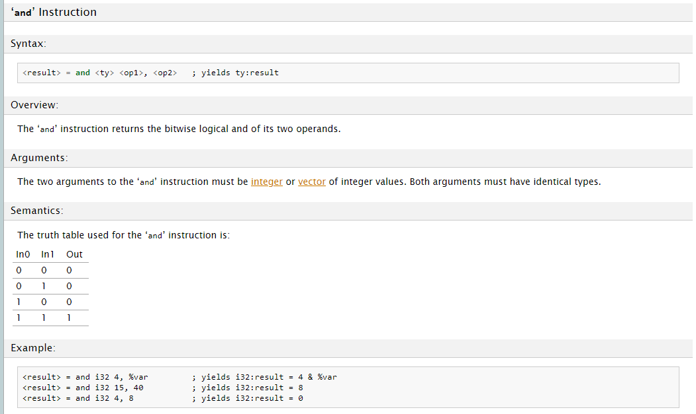
Semantics of corner cases?
What’s the result of:
and i8 %x, poison
and i1 false, poison
and i32 0, poison

