Slide 1
Provably Correct Peephole Optimizations with Alive
Nuno Lopes
MSR
David Menendez Santosh Nagarakatte
Rutgers Univ.
John Regehr
Univ. of Utah
Notes:
Automatic verification

Slide 2
Compilers are Buggy
Csmith [PLDI’11]:
79 bugs in GCC (25 P1)
202 bugs in LLVM
2 wrong-code bugs in CompCert
Orion [PLDI’14]:
40 wrong-code bugs in GCC
42 wrong-code bugs in LLVM
Last Week:
439 open wrong-code bug reports in GCC (out of 9,691)
24 open wrong-code bug reports in LLVM (out of 6,761)

Slide 3
Buggy Compilers = Security Bugs
CVE-2006-1902
GCC 4.1/4.2 (fold-const.c) had a bug that could remove valid pointer comparisons
Result: Removed some bounds checks from programs

Slide 4
Peephole Optimizers are Particularly Buggy
LLVM’s InstCombine (a peephole optimizer) had the most bugs reported by fuzzing tools
InstCombine has 20,000 lines of C++
Semantics of LLVM IR are tricky; InstCombine exploits the corner cases to improve performance:
Undefined behavior, poison values, undefined values, overflows, …

Slide 5
Optimizations are Easy to Get Wrong
int a = x << c;
int b = a / d;
int t = d / (1 << c);
int b = x / t;
x * 2^{c} / d
x / (d / 2^{c})
= x / d * 2^{c}
= x * 2^{c} / d
(c and d are constants)
Notes:
School math vs compiler math

Slide 6
Optimizations are Easy to Get Wrong
int a = x << c;
int b = a / d;
int t = d / (1 << c);
int b = x / t;
ERROR: Domain of definedness of Target is smaller than Source's for i4 %b
Example:
%X i4 = 0x0 (0)
c i4 = 0x3 (3)
d i4 = 0x7 (7)
%a i4 = 0x0 (0)
(1 << c) i4 = 0x8 (8, -8)
%t i4 = 0x0 (0)
Source value: 0x0 (0)
Target value: undef
LLVM bug #21245
Notes:
Even people that do this everyday get it wrong

Slide 7
Implementing Peephole Optimizers
{
Value *Op1C = Op1;
BinaryOperator *BO = dyn_cast<BinaryOperator>(Op0);
if (!BO ||
(BO->getOpcode() != Instruction::UDiv &&
BO->getOpcode() != Instruction::SDiv)) {
Op1C = Op0;
BO = dyn_cast<BinaryOperator>(Op1);
}
Value *Neg = dyn_castNegVal(Op1C);
if (BO && BO->hasOneUse() &&
(BO->getOperand(1) == Op1C || BO->getOperand(1) == Neg) &&
(BO->getOpcode() == Instruction::UDiv ||
BO->getOpcode() == Instruction::SDiv)) {
Value *Op0BO = BO->getOperand(0), *Op1BO = BO->getOperand(1);
// If the division is exact, X % Y is zero, so we end up with X or -X.
if (PossiblyExactOperator *SDiv = dyn_cast<PossiblyExactOperator>(BO))
if (SDiv->isExact()) {
if (Op1BO == Op1C)
return ReplaceInstUsesWith(I, Op0BO);
return BinaryOperator::CreateNeg(Op0BO);
}
Value *Rem;
if (BO->getOpcode() == Instruction::UDiv)
Rem = Builder->CreateURem(Op0BO, Op1BO);
else
Rem = Builder->CreateSRem(Op0BO, Op1BO);
Rem->takeName(BO);
if (Op1BO == Op1C)
return BinaryOperator::CreateSub(Op0BO, Rem);
return BinaryOperator::CreateSub(Rem, Op0BO);
}
}

Slide 8
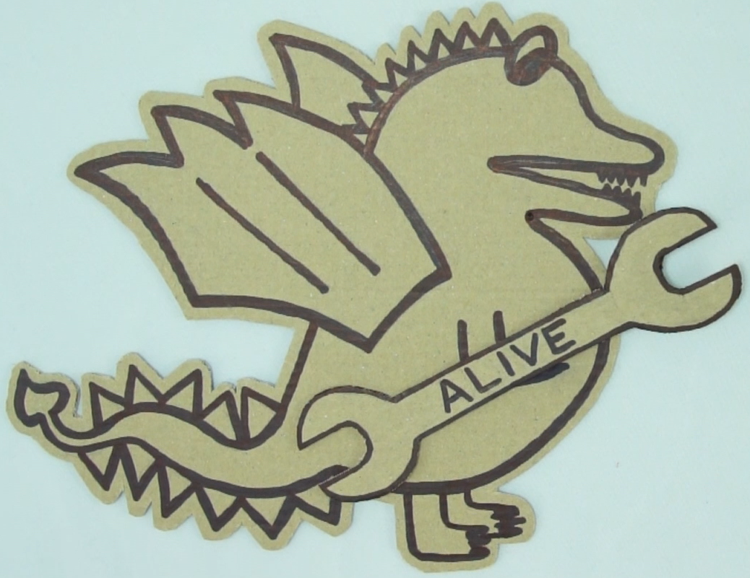
Alive
New language and tool for:
Specifying peephole optimizations
Proving them correct (or generate a counterexample)
Generating C++ code for a compiler
Design point: both practical and formal

Slide 9
A Simple Peephole Optimization
{
Value *Op1C = Op1;
BinaryOperator *BO = dyn_cast<BinaryOperator>(Op0);
if (!BO ||
(BO->getOpcode() != Instruction::UDiv &&
BO->getOpcode() != Instruction::SDiv)) {
Op1C = Op0;
BO = dyn_cast<BinaryOperator>(Op1);
}
Value *Neg = dyn_castNegVal(Op1C);
if (BO && BO->hasOneUse() &&
(BO->getOperand(1) == Op1C || BO->getOperand(1) == Neg) &&
(BO->getOpcode() == Instruction::UDiv ||
BO->getOpcode() == Instruction::SDiv)) {
Value *Op0BO = BO->getOperand(0), *Op1BO = BO->getOperand(1);
// If the division is exact, X % Y is zero, so we end up with X or -X.
if (PossiblyExactOperator *SDiv = dyn_cast<PossiblyExactOperator>(BO))
if (SDiv->isExact()) {
if (Op1BO == Op1C)
return ReplaceInstUsesWith(I, Op0BO);
return BinaryOperator::CreateNeg(Op0BO);
}
Value *Rem;
if (BO->getOpcode() == Instruction::UDiv)
Rem = Builder->CreateURem(Op0BO, Op1BO);
else
Rem = Builder->CreateSRem(Op0BO, Op1BO);
Rem->takeName(BO);
if (Op1BO == Op1C)
return BinaryOperator::CreateSub(Op0BO, Rem);
return BinaryOperator::CreateSub(Rem, Op0BO);
}
}
int f(int x, int y) {
return (x / y) * y;
}
Compile to LLVM IR
define i32 @f(i32 %x, i32 %y) {
%1 = sdiv i32 %x, %y
%2 = mul i32 %1, %y
ret i32 %2
}
Optimize
define i32 @f(i32 %x, i32 %y) {
%1 = srem i32 %x, %y
%2 = sub i32 %x, %1
ret i32 %2
}

Slide 10
A Simple Peephole Optimization
{
Value *Op1C = Op1;
BinaryOperator *BO = dyn_cast<BinaryOperator>(Op0);
if (!BO ||
(BO->getOpcode() != Instruction::UDiv &&
BO->getOpcode() != Instruction::SDiv)) {
Op1C = Op0;
BO = dyn_cast<BinaryOperator>(Op1);
}
Value *Neg = dyn_castNegVal(Op1C);
if (BO && BO->hasOneUse() &&
(BO->getOperand(1) == Op1C || BO->getOperand(1) == Neg) &&
(BO->getOpcode() == Instruction::UDiv ||
BO->getOpcode() == Instruction::SDiv)) {
Value *Op0BO = BO->getOperand(0), *Op1BO = BO->getOperand(1);
// If the division is exact, X % Y is zero, so we end up with X or -X.
if (PossiblyExactOperator *SDiv = dyn_cast<PossiblyExactOperator>(BO))
if (SDiv->isExact()) {
if (Op1BO == Op1C)
return ReplaceInstUsesWith(I, Op0BO);
return BinaryOperator::CreateNeg(Op0BO);
}
Value *Rem;
if (BO->getOpcode() == Instruction::UDiv)
Rem = Builder->CreateURem(Op0BO, Op1BO);
else
Rem = Builder->CreateSRem(Op0BO, Op1BO);
Rem->takeName(BO);
if (Op1BO == Op1C)
return BinaryOperator::CreateSub(Op0BO, Rem);
return BinaryOperator::CreateSub(Rem, Op0BO);
}
}
define i32 @f(i32 %x, i32 %y) {
%1 = sdiv i32 %x, %y
%2 = mul i32 %1, %y
ret i32 %2
}
=>
define i32 @f(i32 %x, i32 %y) {
%1 = srem i32 %x, %y
%2 = sub i32 %x, %1
ret i32 %2
}
define i32 @f(i32 %x, i32 %y) {
%1 = sdiv i32 %x, %y
%2 = mul i32 %1, %y
ret i32 %2
}
Optimize
define i32 @f(i32 %x, i32 %y) {
%1 = srem i32 %x, %y
%2 = sub i32 %x, %1
ret i32 %2
}

Slide 11
A Simple Peephole Optimization
{
Value *Op1C = Op1;
BinaryOperator *BO = dyn_cast<BinaryOperator>(Op0);
if (!BO ||
(BO->getOpcode() != Instruction::UDiv &&
BO->getOpcode() != Instruction::SDiv)) {
Op1C = Op0;
BO = dyn_cast<BinaryOperator>(Op1);
}
Value *Neg = dyn_castNegVal(Op1C);
if (BO && BO->hasOneUse() &&
(BO->getOperand(1) == Op1C || BO->getOperand(1) == Neg) &&
(BO->getOpcode() == Instruction::UDiv ||
BO->getOpcode() == Instruction::SDiv)) {
Value *Op0BO = BO->getOperand(0), *Op1BO = BO->getOperand(1);
// If the division is exact, X % Y is zero, so we end up with X or -X.
if (PossiblyExactOperator *SDiv = dyn_cast<PossiblyExactOperator>(BO))
if (SDiv->isExact()) {
if (Op1BO == Op1C)
return ReplaceInstUsesWith(I, Op0BO);
return BinaryOperator::CreateNeg(Op0BO);
}
Value *Rem;
if (BO->getOpcode() == Instruction::UDiv)
Rem = Builder->CreateURem(Op0BO, Op1BO);
else
Rem = Builder->CreateSRem(Op0BO, Op1BO);
Rem->takeName(BO);
if (Op1BO == Op1C)
return BinaryOperator::CreateSub(Op0BO, Rem);
return BinaryOperator::CreateSub(Rem, Op0BO);
}
}
%1 = sdiv i32 %x, %y
%2 = mul i32 %1, %y
=>
%t = srem i32 %x, %y
%2 = sub i32 %x, %t

Slide 12
A Simple Peephole Optimization
{
Value *Op1C = Op1;
BinaryOperator *BO = dyn_cast<BinaryOperator>(Op0);
if (!BO ||
(BO->getOpcode() != Instruction::UDiv &&
BO->getOpcode() != Instruction::SDiv)) {
Op1C = Op0;
BO = dyn_cast<BinaryOperator>(Op1);
}
Value *Neg = dyn_castNegVal(Op1C);
if (BO && BO->hasOneUse() &&
(BO->getOperand(1) == Op1C || BO->getOperand(1) == Neg) &&
(BO->getOpcode() == Instruction::UDiv ||
BO->getOpcode() == Instruction::SDiv)) {
Value *Op0BO = BO->getOperand(0), *Op1BO = BO->getOperand(1);
// If the division is exact, X % Y is zero, so we end up with X or -X.
if (PossiblyExactOperator *SDiv = dyn_cast<PossiblyExactOperator>(BO))
if (SDiv->isExact()) {
if (Op1BO == Op1C)
return ReplaceInstUsesWith(I, Op0BO);
return BinaryOperator::CreateNeg(Op0BO);
}
Value *Rem;
if (BO->getOpcode() == Instruction::UDiv)
Rem = Builder->CreateURem(Op0BO, Op1BO);
else
Rem = Builder->CreateSRem(Op0BO, Op1BO);
Rem->takeName(BO);
if (Op1BO == Op1C)
return BinaryOperator::CreateSub(Op0BO, Rem);
return BinaryOperator::CreateSub(Rem, Op0BO);
}
}
%1 = sdiv i32 %x, %y
%2 = mul i32 %1, %y
=>
%t = srem i32 %x, %y
%2 = sub i32 %x, %t

Slide 13
A Simple Peephole Optimization
{
Value *Op1C = Op1;
BinaryOperator *BO = dyn_cast<BinaryOperator>(Op0);
if (!BO ||
(BO->getOpcode() != Instruction::UDiv &&
BO->getOpcode() != Instruction::SDiv)) {
Op1C = Op0;
BO = dyn_cast<BinaryOperator>(Op1);
}
Value *Neg = dyn_castNegVal(Op1C);
if (BO && BO->hasOneUse() &&
(BO->getOperand(1) == Op1C || BO->getOperand(1) == Neg) &&
(BO->getOpcode() == Instruction::UDiv ||
BO->getOpcode() == Instruction::SDiv)) {
Value *Op0BO = BO->getOperand(0), *Op1BO = BO->getOperand(1);
// If the division is exact, X % Y is zero, so we end up with X or -X.
if (PossiblyExactOperator *SDiv = dyn_cast<PossiblyExactOperator>(BO))
if (SDiv->isExact()) {
if (Op1BO == Op1C)
return ReplaceInstUsesWith(I, Op0BO);
return BinaryOperator::CreateNeg(Op0BO);
}
Value *Rem;
if (BO->getOpcode() == Instruction::UDiv)
Rem = Builder->CreateURem(Op0BO, Op1BO);
else
Rem = Builder->CreateSRem(Op0BO, Op1BO);
Rem->takeName(BO);
if (Op1BO == Op1C)
return BinaryOperator::CreateSub(Op0BO, Rem);
return BinaryOperator::CreateSub(Rem, Op0BO);
}
}
%1 = sdiv %x, %y
%2 = mul %1, %y
=>
%t = srem %x, %y
%2 = sub %x, %t

Slide 14
A Simple Peephole Optimization
{
Value *Op1C = Op1;
BinaryOperator *BO = dyn_cast<BinaryOperator>(Op0);
if (!BO ||
(BO->getOpcode() != Instruction::UDiv &&
BO->getOpcode() != Instruction::SDiv)) {
Op1C = Op0;
BO = dyn_cast<BinaryOperator>(Op1);
}
Value *Neg = dyn_castNegVal(Op1C);
if (BO && BO->hasOneUse() &&
(BO->getOperand(1) == Op1C || BO->getOperand(1) == Neg) &&
(BO->getOpcode() == Instruction::UDiv ||
BO->getOpcode() == Instruction::SDiv)) {
Value *Op0BO = BO->getOperand(0), *Op1BO = BO->getOperand(1);
// If the division is exact, X % Y is zero, so we end up with X or -X.
if (PossiblyExactOperator *SDiv = dyn_cast<PossiblyExactOperator>(BO))
if (SDiv->isExact()) {
if (Op1BO == Op1C)
return ReplaceInstUsesWith(I, Op0BO);
return BinaryOperator::CreateNeg(Op0BO);
}
Value *Rem;
if (BO->getOpcode() == Instruction::UDiv)
Rem = Builder->CreateURem(Op0BO, Op1BO);
else
Rem = Builder->CreateSRem(Op0BO, Op1BO);
Rem->takeName(BO);
if (Op1BO == Op1C)
return BinaryOperator::CreateSub(Op0BO, Rem);
return BinaryOperator::CreateSub(Rem, Op0BO);
}
}
Name: sdiv general
%1 = sdiv %x, %y
%2 = mul %1, %y
=>
%t = srem %x, %y
%2 = sub %x, %t
Name: sdiv exact
%1 = sdiv exact %x, %y
%2 = mul %1, %y
=>
%2 = %x

Slide 15
Alive Language
Precondition
Pre: C2 % (1<<C1) == 0
%s = shl nsw %X, C1
%r = sdiv %s, C2
=>
%r = sdiv %X, C2/(1<<C1)
Source template
Target template
Predicates in preconditions may be the result of a dataflow analysis.

Slide 16
Alive Language
Pre: C2 % (1<<C1) == 0
%s = shl nsw %X, C1
%r = sdiv %s, C2
=>
%r = sdiv %X, C2/(1<<C1)
Constants
Generalized from LLVM IR:
Symbolic constants
Implicit types

Slide 17


Alive
Typing Constraints
Transformation
Alive
Refinement Constraints
C++

Slide 18
Correctness Criteria
Target invokes undefined behavior only when the source does
Result of target = result of source when source does not invoke undefined behavior
Final memory states are equivalent
LLVM has 3 types of UB:
Poison values
Undef values
True UB
See paper for more details

Slide 19
The story of a new optimization
A developer wrote a new optimization that improves benchmarks:
3.8% perlbmk (SPEC CPU 2000)
1% perlbench (SPEC CPU 2006)
1.2% perlbench (SPEC CPU 2006) w/ LTO+PGO
40 lines of code
August 2014

Slide 20
The story of a new optimization
The first patch was wrong
ERROR: Mismatch in values of %r
Example:
%A i4 = 0x0 (0)
C1 i4 = 0xA (10, -6)
C3 i4 = 0x5 (5)
C2 i4 = 0x2 (2)
%x i4 = 0xA (10, -6)
%i i1 = 0x0 (0)
%y i4 = 0x2 (2)
%j i1 = 0x1 (1, -1)
%and i4 = 0x0 (0)
%lhs i4 = 0xA (10, -6)
Source value: 0x1 (1, -1)
Target value: 0x0 (0)
Pre: isPowerOf2(C1 ^ C2)
%x = add %A, C1
%i = icmp ult %x, C3
%y = add %A, C2
%j = icmp ult %y, C3
%r = or %i, %j
=>
%and = and %A, ~(C1 ^ C2)
%lhs = add %and, umax(C1, C2)
%r = icmp ult %lhs, C3

Slide 21
The story of a new optimization
The second patch was wrong
The third patch was correct!
Still fires on the benchmarks!
Pre: C1 u> C3 &&
C2 u> C3 &&
isPowerOf2(C1 ^ C2) &&
isPowerOf2(-C1 ^ -C2) &&
(-C1 ^ -C2) == ((C3-C1) ^ (C3-C2)) &&
abs(C1-C2) u> C3
%x = add %A, C1
%i = icmp ult %x, C3
%y = add %A, C2
%j = icmp ult %y, C3
%r = or %i, %j
=>
%and = and %A, ~(C1^C2)
%lhs = add %and, umax(C1,C2)
%r = icmp ult %lhs, C3

Slide 22
Experiments
Translated > 300 optimizations from LLVM’s InstCombine to Alive. Found 8 bugs; remaining proved correct.
Automatic optimal post-condition strengthening
Significantly better than developers
Replaced InstCombine with automatically generated code

Slide 23
InstCombine: Stats per File
File | # opts. | # translated | # bugs
AddSub | 67 | 49 | 2
AndOrXor | 165 | 131 | 0
Calls | 80 | - | -
Casts | 77 | - | -
Combining | 63 | - | -
Compares | 245 | - | -
LoadStoreAlloca | 28 | 17 | 0
MulDivRem | 65 | 44 | 6
PHI | 12 | - | -
Select | 74 | 52 | 0
Shifts | 43 | 41 | 0
SimplifyDemanded | 75 | - | -
VectorOps | 34 | - | -
Total | 1,028 | 334 | 8
14% wrong!
Notes:
Found bugs even after all the fuzzing

Slide 24
Optimal Attribute Inference
Pre: C1 % C2 == 0
%m = mul nsw %X, C1
%r = sdiv %m, C2
=>
%r = mul nsw %X, C1/C2
States that the operation will not result in a signed overflow
Notes:
Devs not confident in adding/propagating attributes.

Slide 25
Optimal Attribute Inference
Weakened 1 precondition
Strengthened the postcondition for 70 (21%) optimizations
40% for AddSub, MulDivRem, Shifts
Postconditions state, e.g., when an operation will not overflow
Notes:
Devs not confident in adding/propagating attributes.

Slide 26
Alive is Useful!
Released as open-source in Fall 2014
In use by developers across 6 companies
Already caught dozens of bugs in new patches
Talks about replacing InstCombine

Slide 27
Conclusion
(Peephole) optimizers are huge and buggy
Presented Alive, a DSL+tool to specify peephole optimizations
Usable by compiler developers (easy to learn; friendly interface)
Automatic verification
Generates C++ implementation automatically
Available from https://github.com/nunoplopes/alive/

Slide 29
Instruction Attributes
Instructions may become poison:
NSW: no signed wrap
NUW: no unsigned wrap
Exact: lossless operation
Essential for optimization, but extremely hard to reason by hand

Slide 30
Valid Associativity
%t = add %A, %B
%r = add %t, %C
%t = add %B, %C
%r = add %A, %t
(A + B) + C = A + (B + C)
Notes:
School math works here.

Slide 31
Associativity w/ NSW
%A = 50
%B = -50
%C = -100
%t = add nsw i8 %A, %B
%r = add nsw i8 %t, %C
%t = add nsw i8 %B, %C
%r = add nsw i8 %A, %t
%t = 0
%r = -100
%t = poison (-150)
%r = poison

Slide 32
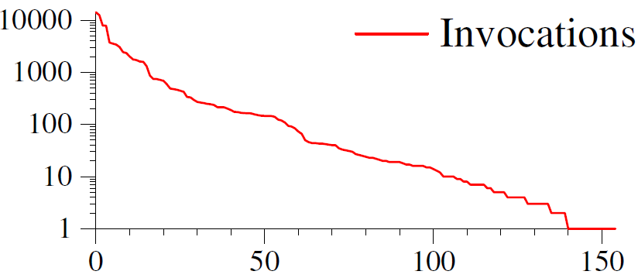
Long Tail of Optimizations
SPEC gives poor code coverage

Slide 33
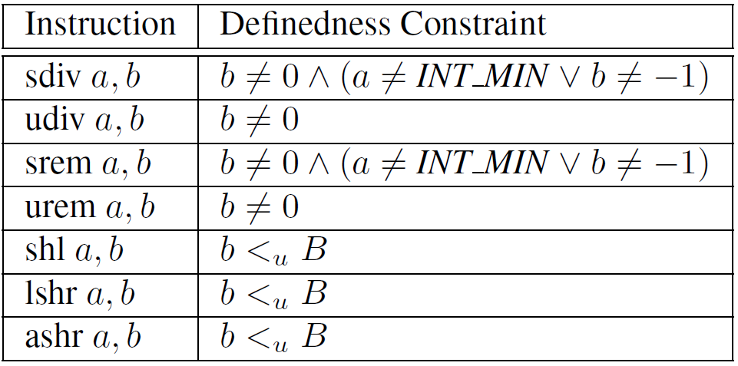
Definedness Constraints

Slide 34
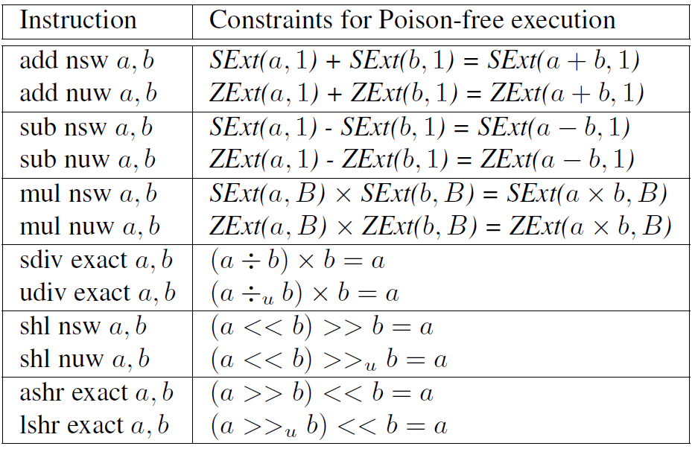
Poison-free Constraints

Slide 35
PR20186: wrong value
%div = sdiv %x, C
%r = sub 0, %div
=>
%r = sdiv %x, -C

Slide 36
PR20189: introduce poison value
%B = sub 0, %A
%C = sub nsw %X, %B
=>
%C = add nsw %X, %A

Slide 37
PR21242: introduce poison value
Pre: isPowerOf2(C1)
%r = mul nsw %x, C1
=>
%r = shl nsw %x, log2(C1)

Slide 38
PR21243: wrong value
Pre: !WillNotOverflowSignedMul(C1, C2)
%Op0 = sdiv %X, C1
%r = sdiv %Op0, C2
=>
%r = 0

Slide 39
PR21245: wrong value
Pre: C2 % (1<<C1) == 0
%s = shl nsw %X, C1
%r = sdiv %s, C2
=>
%r = sdiv %X, (C2 / (1 << C1))

Slide 40
PR21255: introduce undef behavior
%Op0 = lshr %X, C1
%r = udiv %Op0, C2
=>
%r = udiv %X, (C2 << C1)

Slide 41
PR21256: introduce undef behavior
%Op1 = sub 0, %X
%r = srem %Op0, %Op1
=>
%r = srem %Op0, %X

Slide 42
PR21274: introduce undef behavior
Pre: isPowerOf2(%Power)
%shl = shl %Power, %A
%Y = lshr %shl, %B
%r = udiv %X, %Y
=>
%sub = sub %A, %B
%Y = shl %Power, %sub
%r = udiv %X, %Y

Slide 43
Precondition Predicates
equivalentAddressValues
isPowerOf2
isPowerOf2OrZero
isShiftedMask
isSignBit
MaskedValueIsZero
WillNotOverflowSignedAdd
WillNotOverflowUnsignedAdd
WillNotOverflowSignedSub
WillNotOverflowUnsignedSub
WillNotOverflowSignedMul
WillNotOverflowUnsignedMul
WillNotOverflowUnsignedShl

