Slide 1
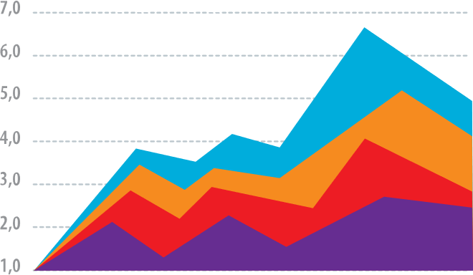
Teach people your main takeaway on the first slide.
Axis labels should be at least 20pt

Slide 2
Who cares? Explain why your finding matters on the 2nd slide.

Slide 3
Teach your methods on slides 3+

Slide 4
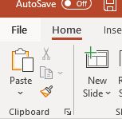
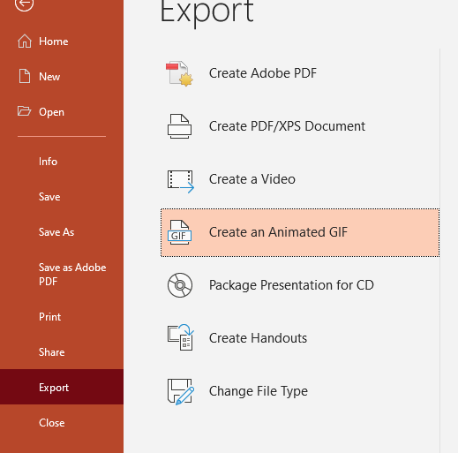
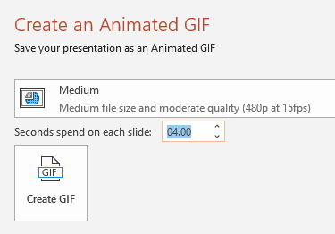
All done? Save as an animated GIF:
1. File
2. Export
3. Create Animated GIF
4. Set Quality to Medium and Seconds to ~4-5

