Slide 1

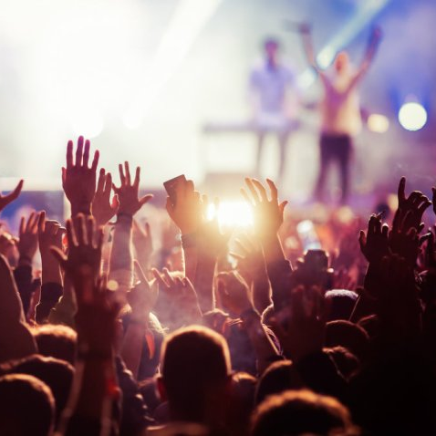
Usability testing
Group 1 – 100 Limites

Slide 2



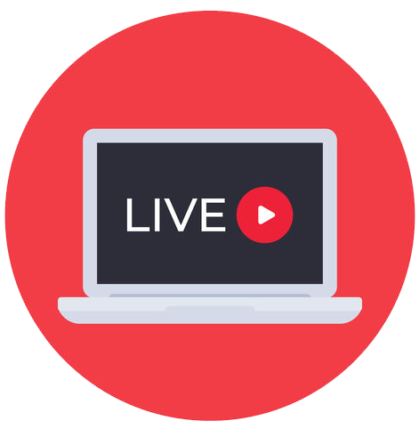
Our idea
Streaming app that allows people to watch music events live online.

Slide 3

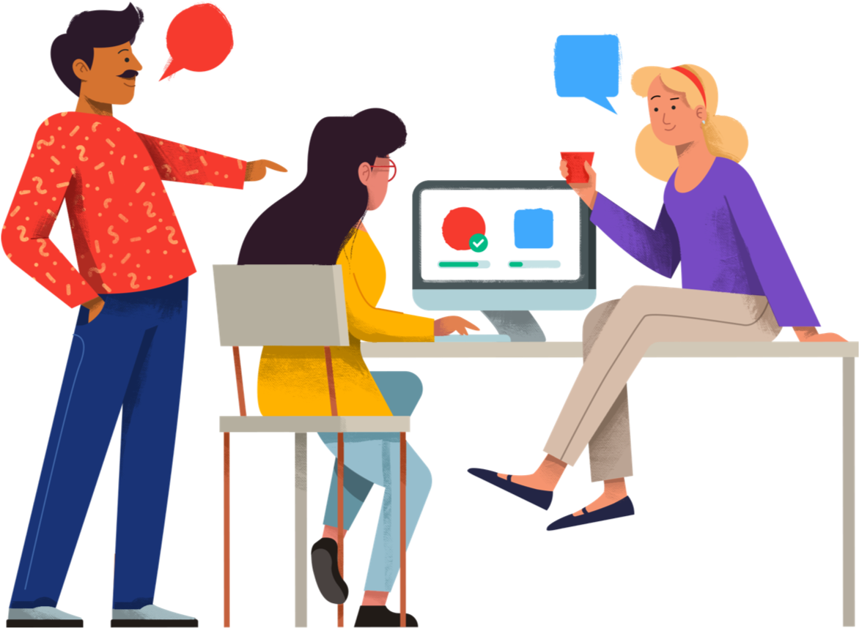
This week
Conducted usability testing
Performed user study for 6 users, representative of our personas (3 music fans and 3 music artists/crew members);
Gathered all the information collected from those tests;
Analyzed the results;
Continued the core development of our fully functional prototype.

Slide 4
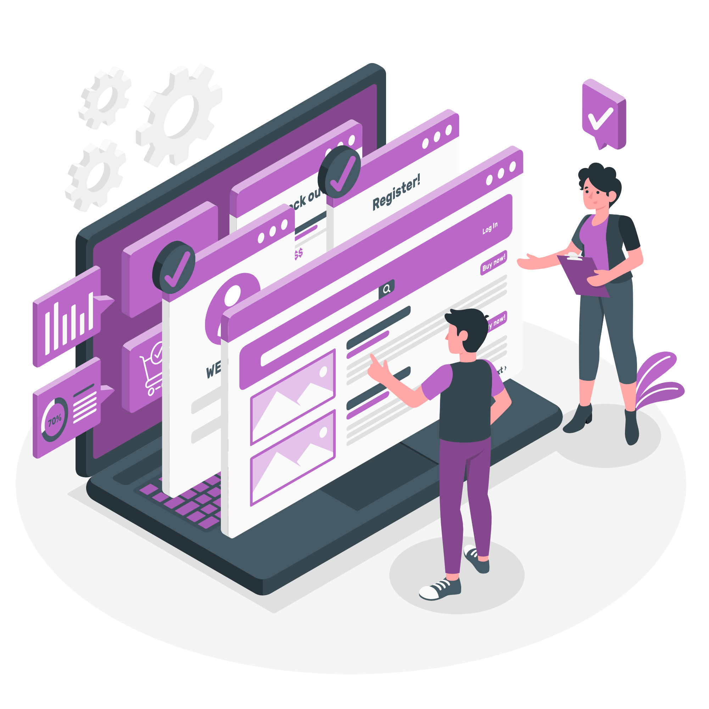
User study methodology

Slide 5

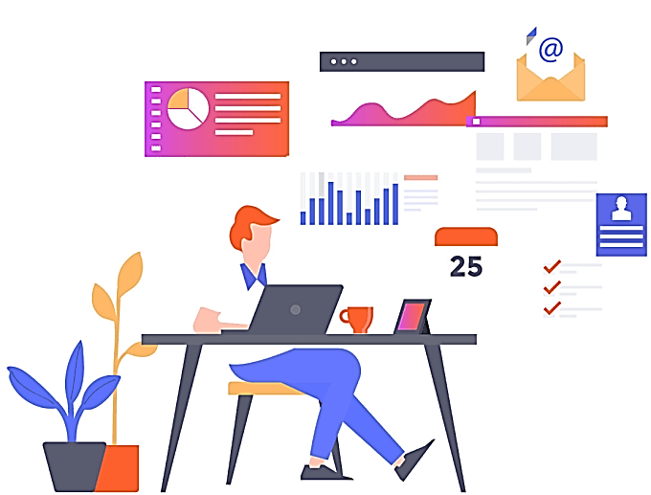
method
The majority of the sessions took place remotely, except when they involved family members;
Moderated – one member of the group supervised the user;
Assessment testing – since we want to test a user's satisfaction with a product and how they will be able to use it;
It is also open-ended (explorative) – users are encouraged to give their opinions.

Slide 6

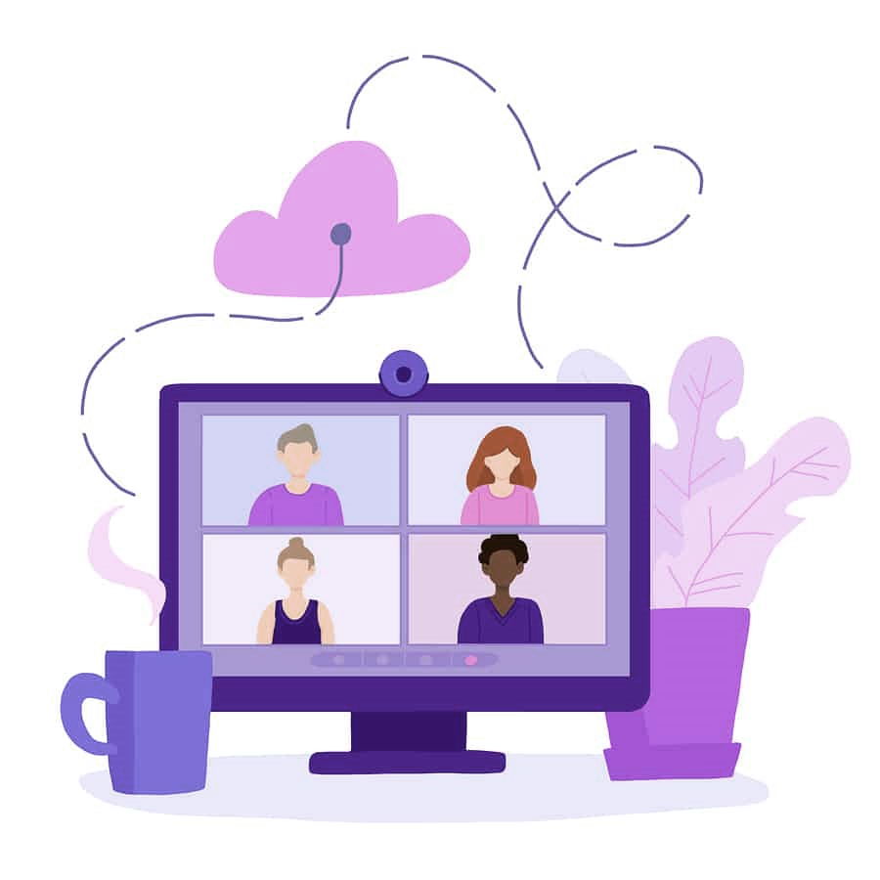
process
Setup
In case of remote testing, a zoom call is needed;
Screen recording is required.
Process
Users are made aware about the context of the test;
The users are asked for their consent, as their screen and
voice are going to be recorded;
Users are asked to perform certain tasks and to answer satisfaction questions;
During the tasks, we count the clicks and time to compare those values with the metric;
Their main difficulties and suggestions are also registered.

Slide 7
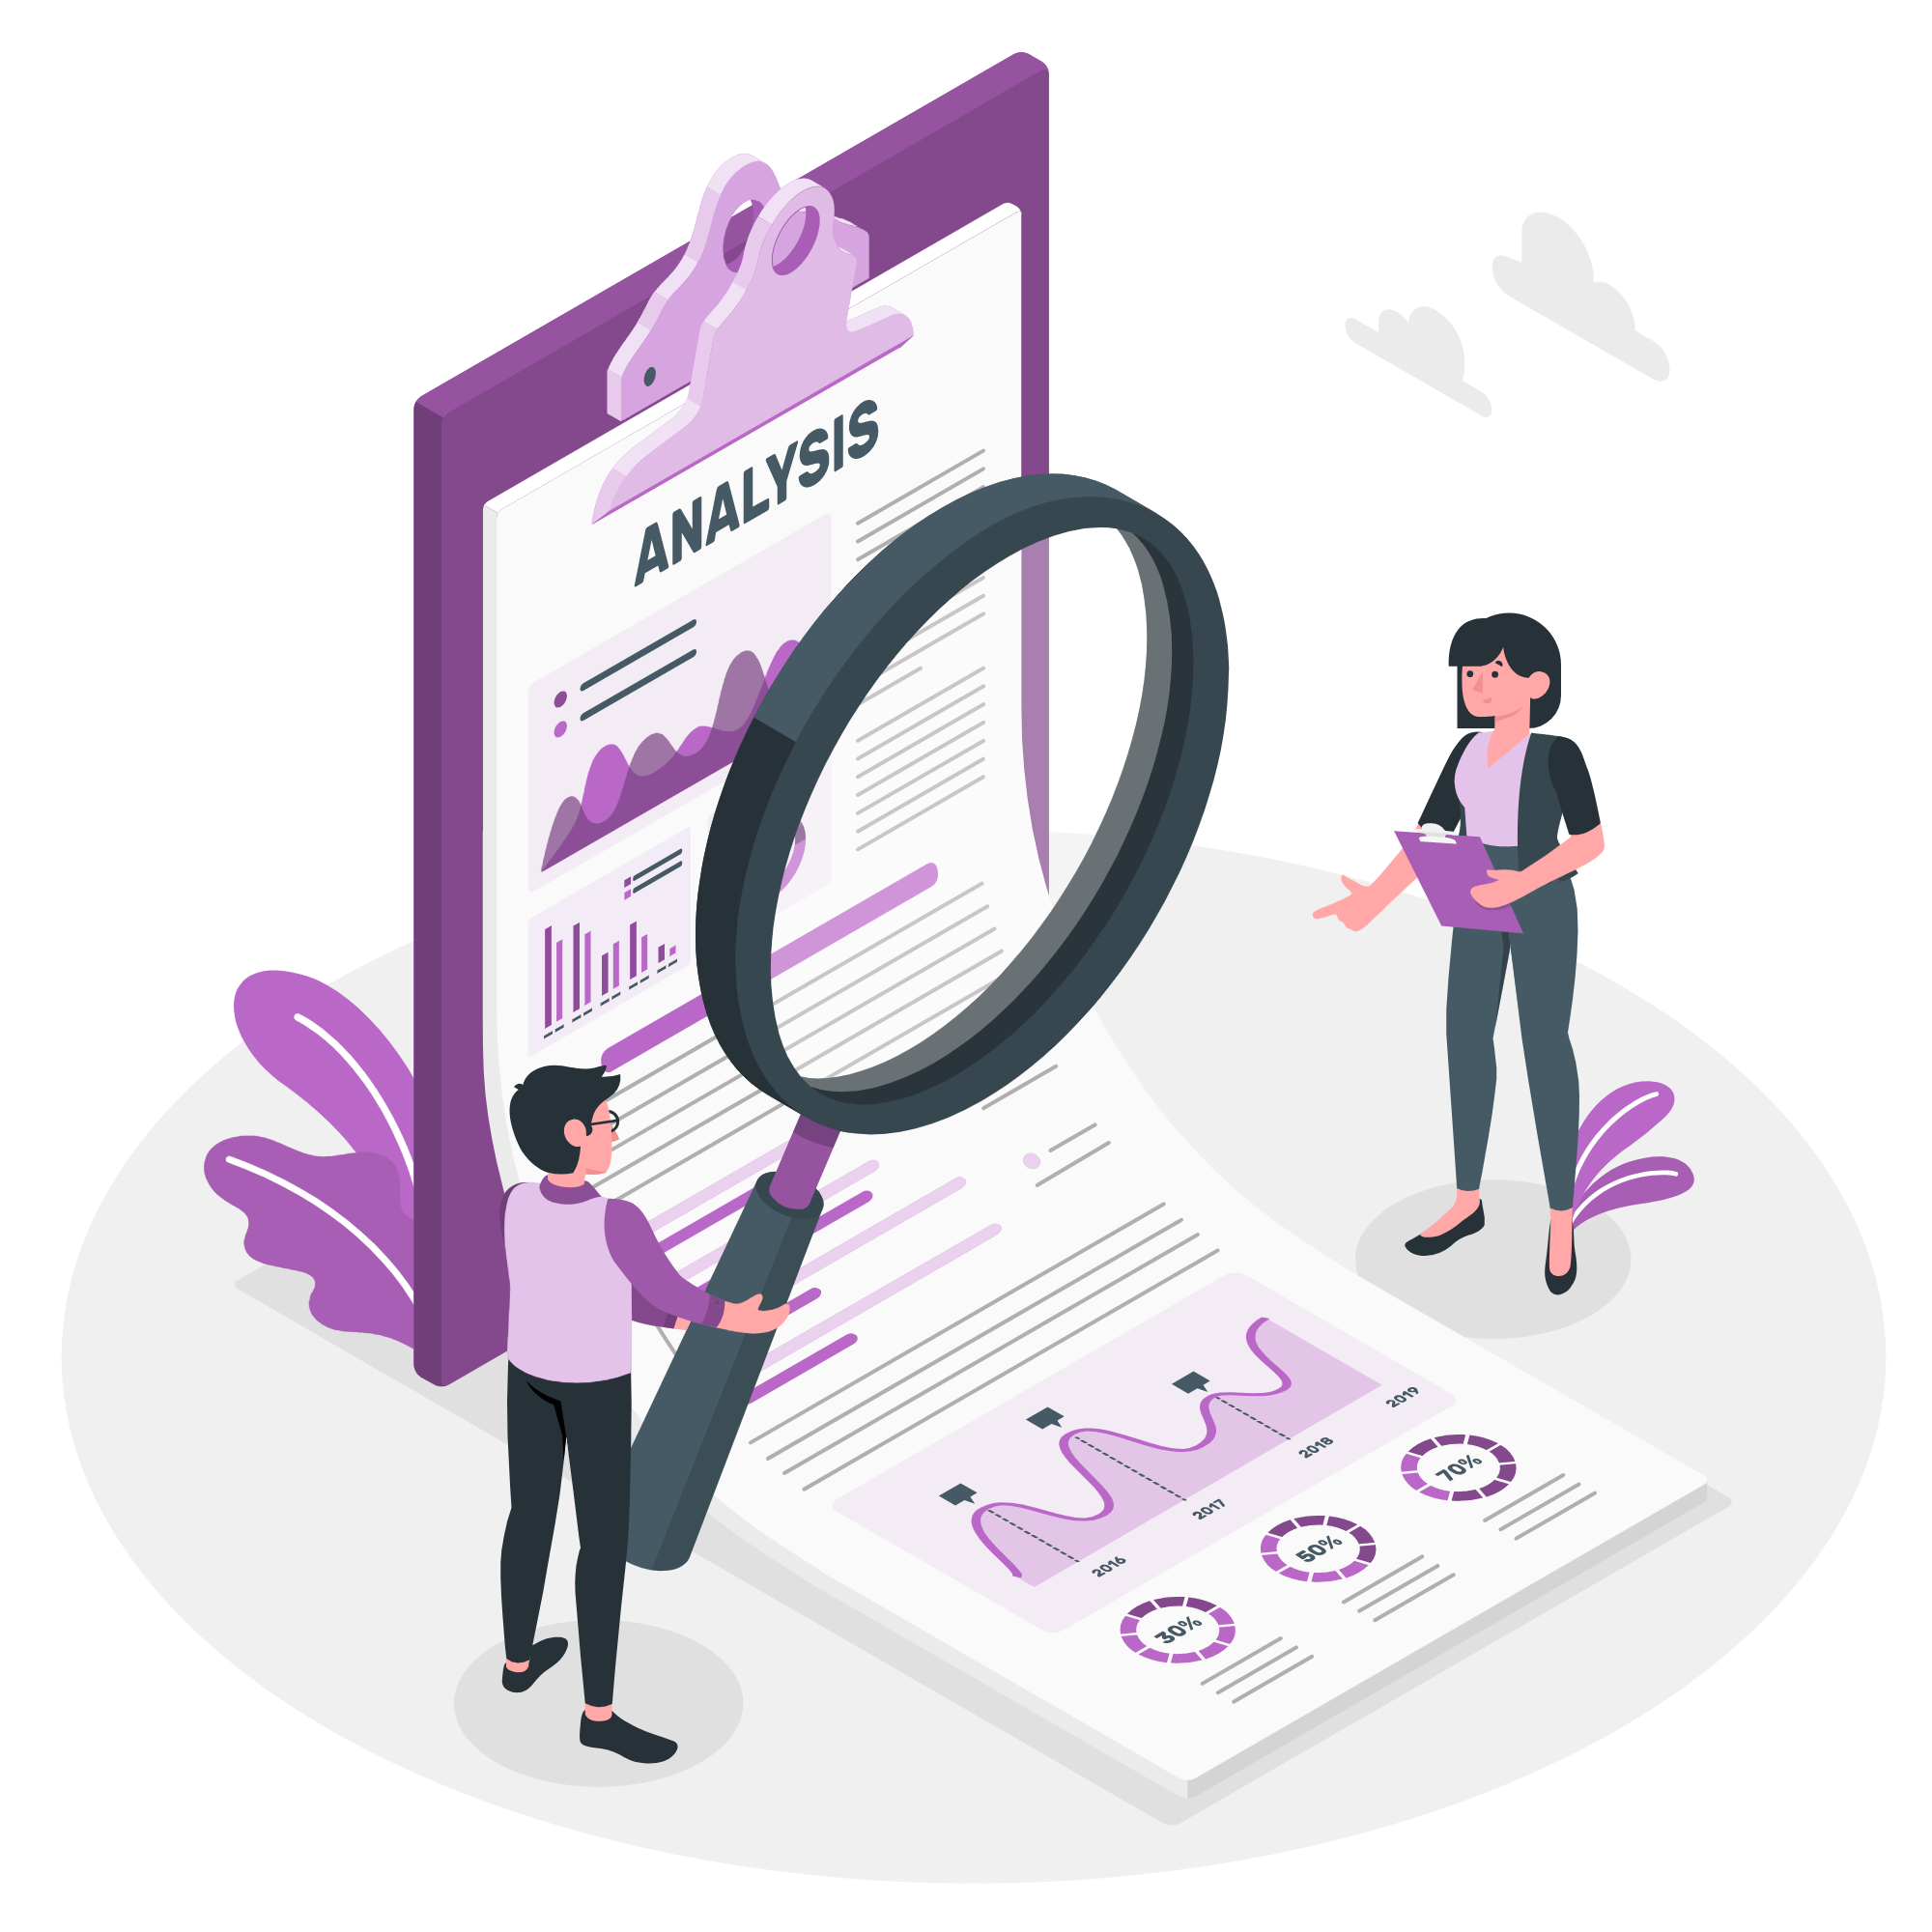
results

Slide 8

Fan Metrics
Task | Time (s) |  | #Clicks |  | Satisfaction
 | Expected | Avg. | Expected | Avg. | Expected | Real
Sign up, see concert info, follow artist | ≤ 55.0 | 55.3 | ≤ 15.0 | 15.0 | 100% (1 or 2) | 100%
Log in, receive notification, buy ticket | ≤ 22.0 | 23.0 | ≤ 11.0 | 10.3 | 100% (1 or 2) | 100%
Go to concert stream see the general chat during the concert | ≤ 30.0 | 27.6 | ≤ 7.0 | 7.0 | 100% (1 or 2) | 66%
Go to voice call and the general chat after the concert | ≤ 35.0 | 34.0 | ≤ 7.0 | 6.6 | 100% (1 or 2) | 100%

Slide 9
Artist Metrics
Task | Time (s) |  | #Clicks |  | Satisfaction
 | Expected | Avg. | Expected | Avg. | Expected | Real
Sign up and create concert | ≤ 40.0 | 40.0 | ≤ 20.0 | 20.0 | 100% (1 or 2) | 100%
Start concert stream and go to the chat | ≤ 15.0 | 14.0 | ≤ 4.0 | 3.0 | 100% (1 or 2) | 100%
End stream and go to voice call | ≤ 20.0 | 11.0 | ≤ 5.0 | 4.0 | 100% (1 or 2) | 66%

Slide 10

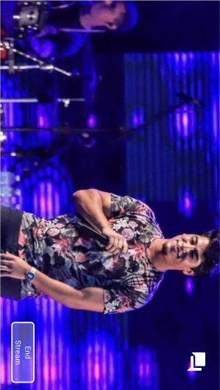

difficulties
Artists
Detect the chat option in full screen mode;
Understand that the call already started.
Fans
Know when the concert starts (because the notification is hard to detect);
Identify where the information about the date and time of the concert is located.

Slide 11

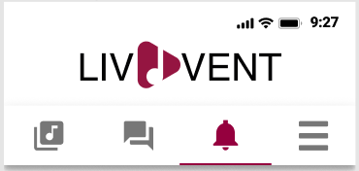
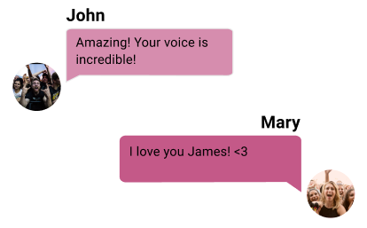
feedback
Artists
The call should start only when the artist wants to do that.
Fans
Make new notifications and new messages more easily apparent;
Messages sent by the user are not easily distinguished from the messages sent by other fans;
There could be a profile for music fans as well.
Both
The voice calls could have a video option.

Slide 12
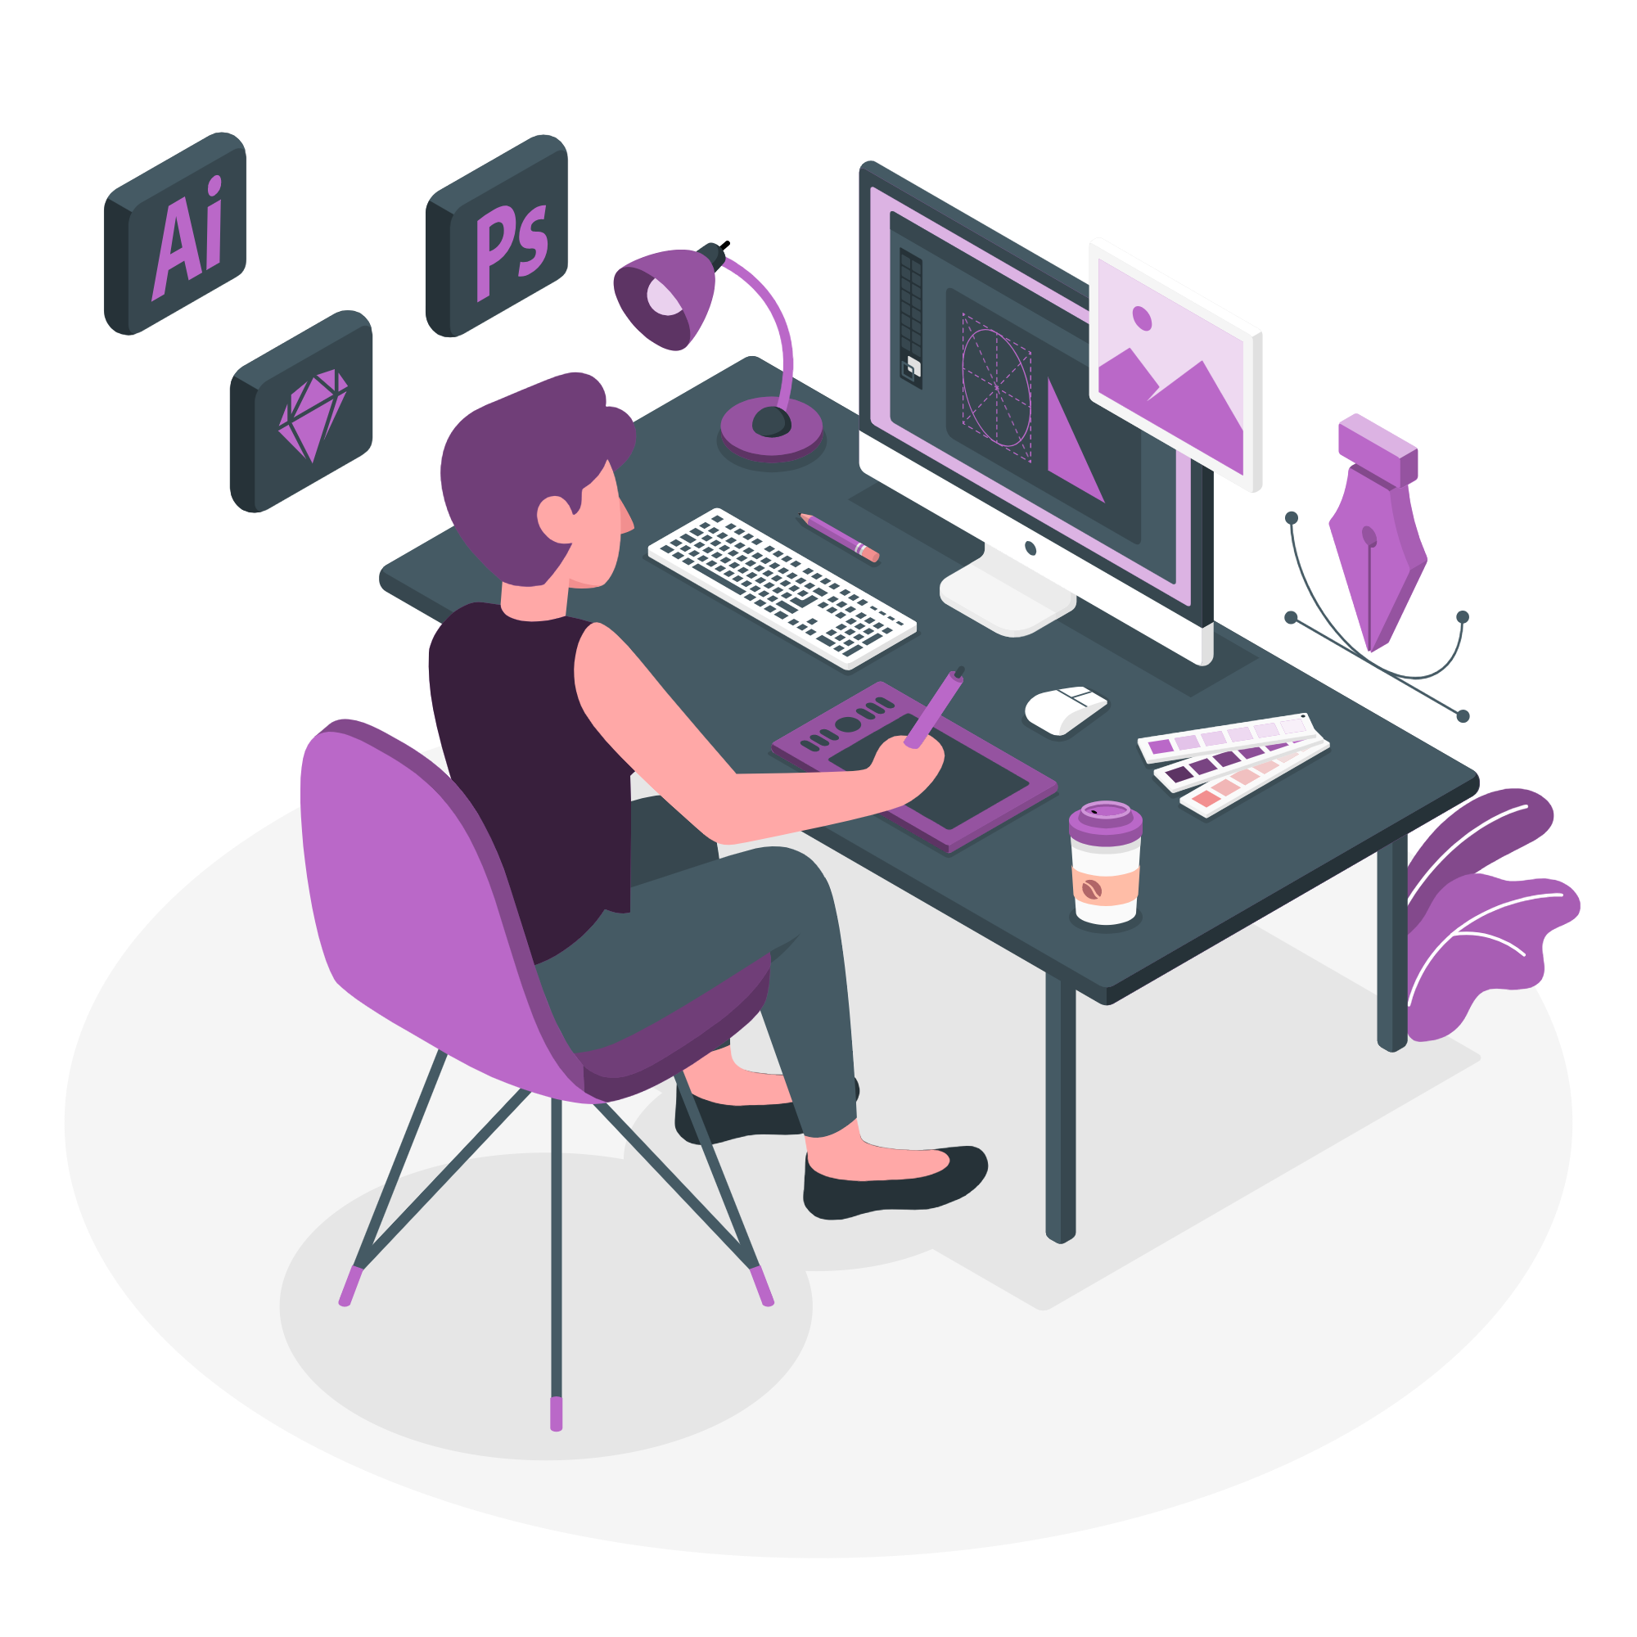
Design implications

Slide 13

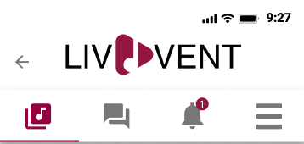
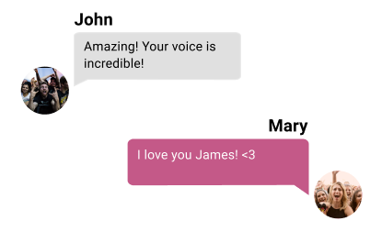
improvements
Have a profile for the fans;
Have an indicator to highlight new messages and notifications next to the respective icon in the menu;
Change the color contrast between the messages sent by the user and by other fans.

Slide 14
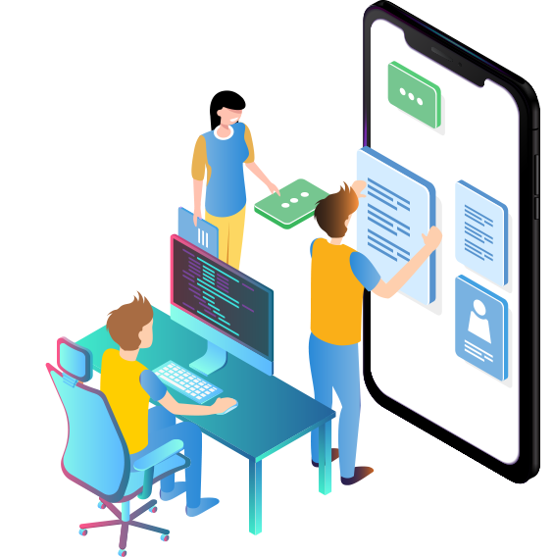

Next steps
Continue to work with flutter to develop our fully functional prototype.
Perform minor touch ups to the UI layout if the need arises.

