Slide 1

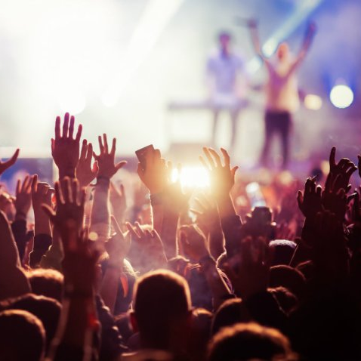
High-fidelity prototype
Group 1 – 100 Limites

Slide 2



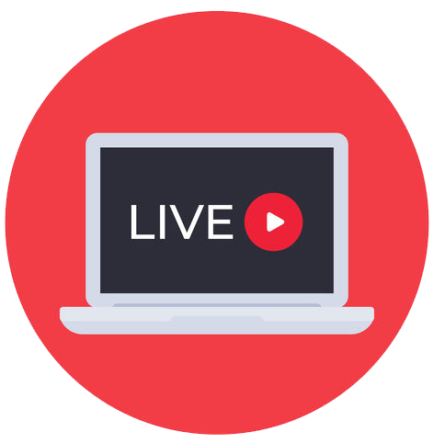
Our idea
Streaming app that allows people to watch music events live online.

Slide 3

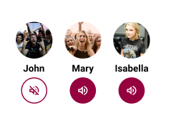
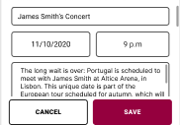
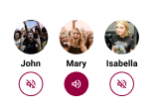
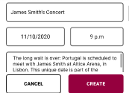
This week
Improved low-functionality prototype
Added new screens to allow more transitions and operations.
Cleaned and changed a few screens’ UI and structure.
Fixed some inconsistencies.
Started the development of the fully functional prototype using Flutter.

Slide 4
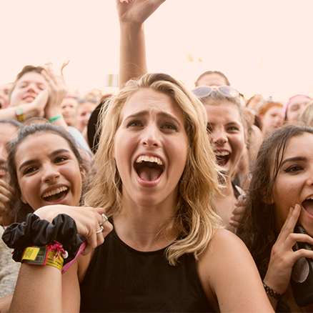
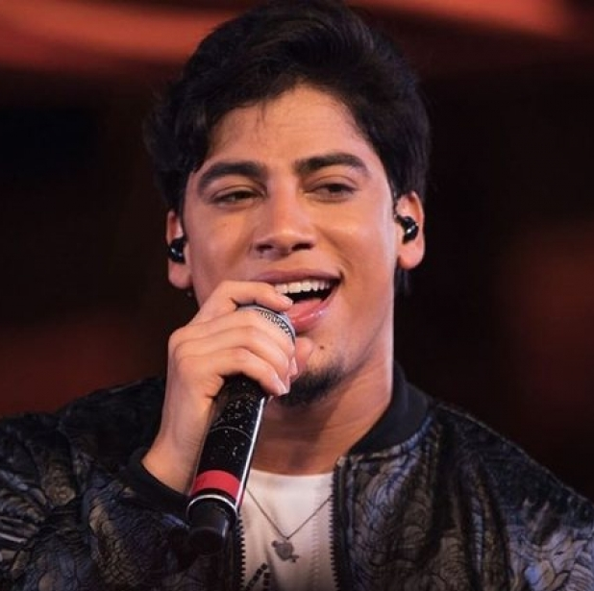
Personas
Music Events Fan
Music Artist

Slide 5



Critical tasks
Streaming
Communication
Notification

Slide 6

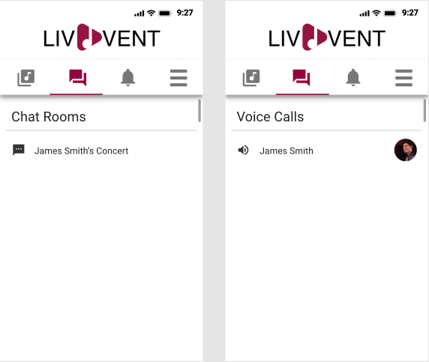
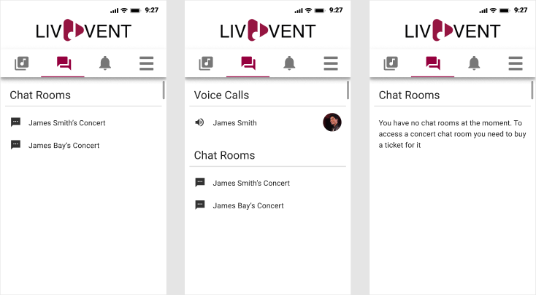
Feedback incorporation
Before it only showed one or the other
Voice Calls only show up when there is one
With no chat rooms

Slide 7

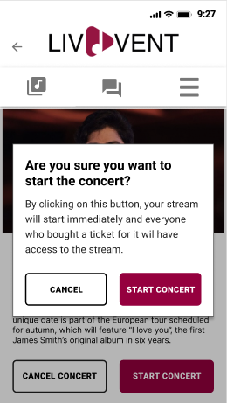
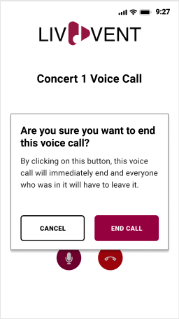

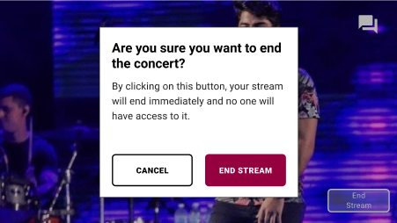
improvements
Dialog box will pop up to confirm if artist wants to
Start stream
End stream
End a voice call

Slide 8
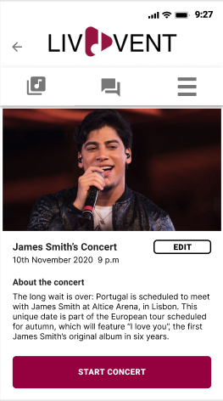
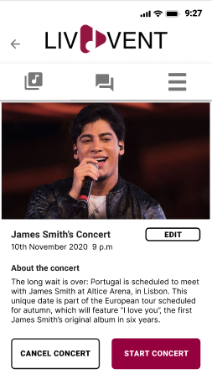
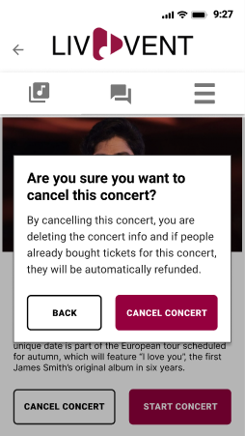
improvements
Can cancel a concert
Dialog box will pop up to confirm the action

Slide 9
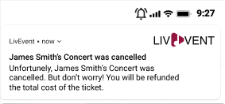
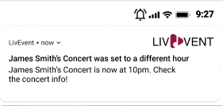
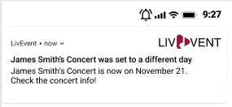
improvements
Fans that paid for a ticket will receive
notifications about concert changes
Artist cancelled the concert
Artist changed the time of the concert
Artist changed the day of the concert

Slide 10
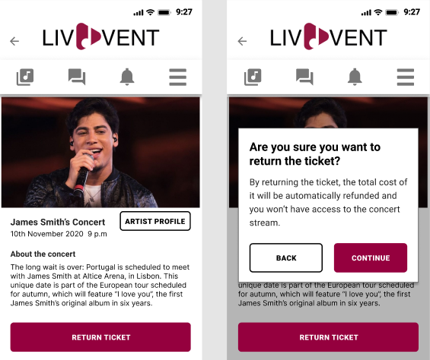
improvements
Fans can return their ticket
Dialog box will pop up to confirm the action

Slide 11
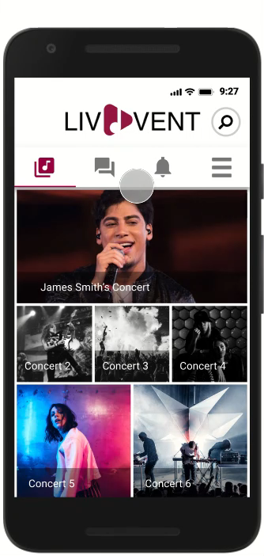
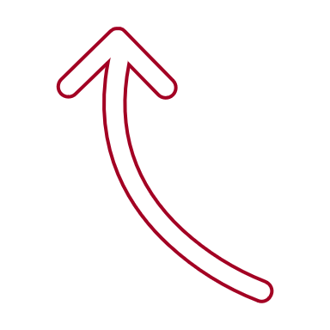
Fan side
Favorite artists will show up first
Choose the
concert they want
Go to paid concerts
Go to stream
streaming

Slide 12
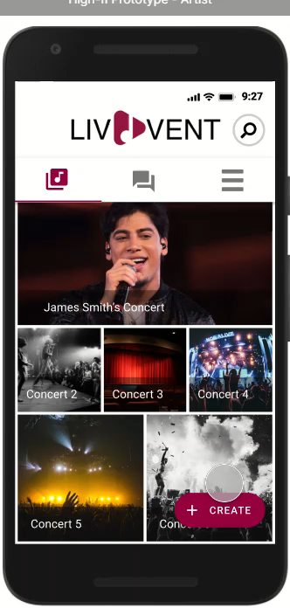
Artist side
Create concert
End stream
streaming
Start a stream

Slide 13
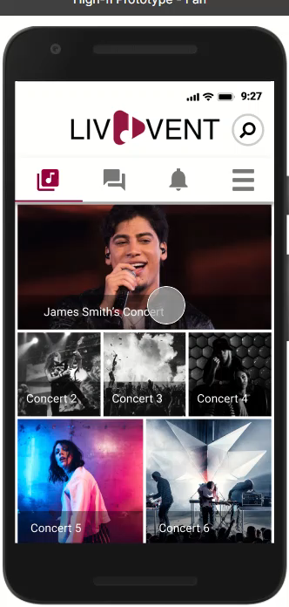
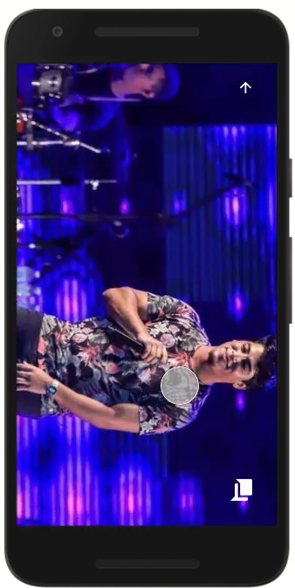
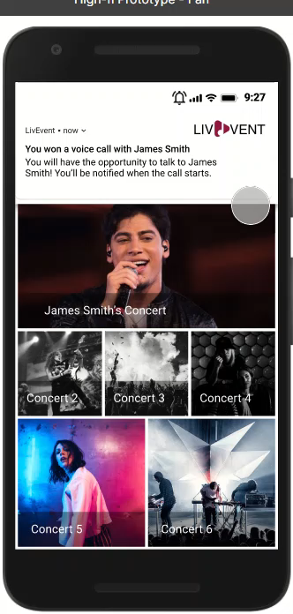
Fan side
Communication
Talk to other fans and the artist before or after the concert
Win a voice call with the artist after the concert
Talk to other fans and the artist during the concert

Slide 14
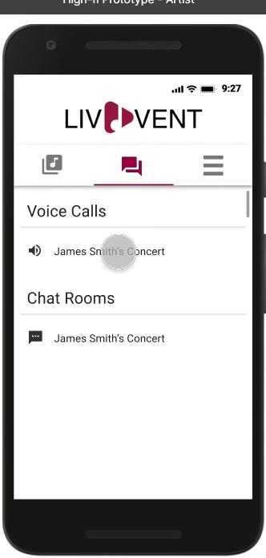
Artist side
Can mute each fan at will
Do voice call
with 3 fans chosen randomly by the app
Communication

Slide 15
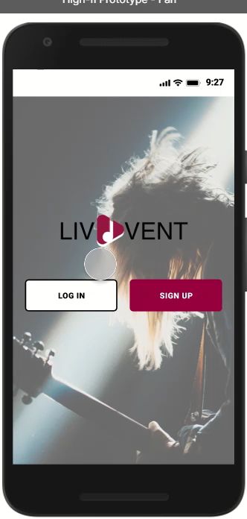
There are other notifications shown before
Receive notification when a new concert of a favorite artist
is available
Fan side
Check notification history
notification
Delete notification

Slide 16
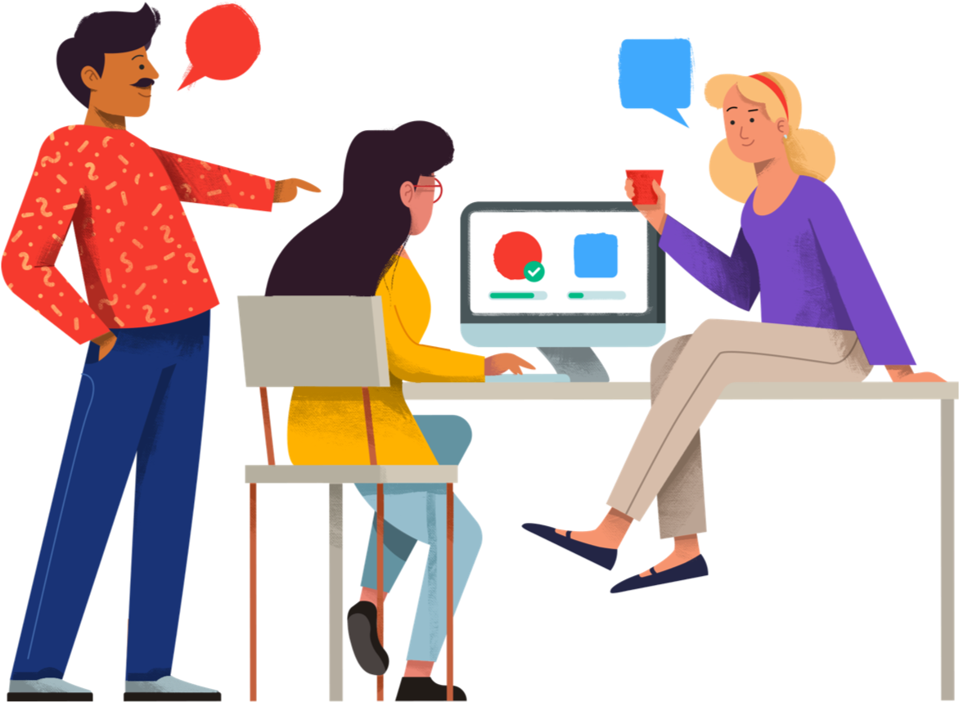

Next steps
Continue to work with flutter to develop our fully functional prototype.
Prepare a formative usability test.
Conduct the user study and analyze its results.

