Slide 1

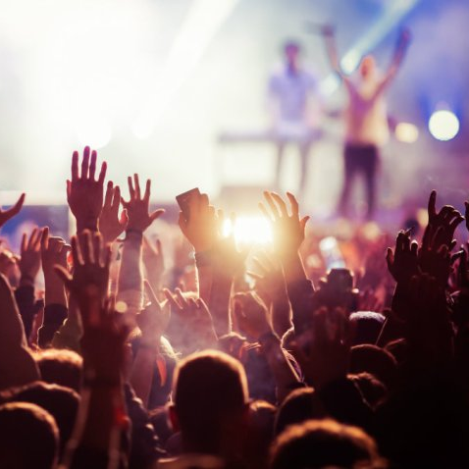
Fully functional prototype
Group 1 – 100 Limites

Slide 2




Our idea
Streaming app that allows people to watch music events live online.

Slide 3

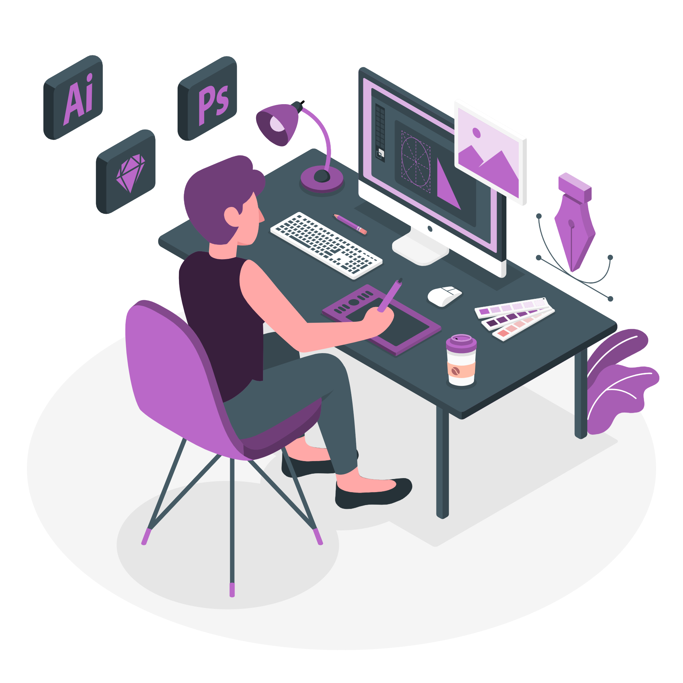
This week
Fully Functional Prototype
Continued the backend development of our fully functional prototype.
Developed the frontend of the fully functional prototype.
Incorporated last week’s feedback on our design.

Slide 4
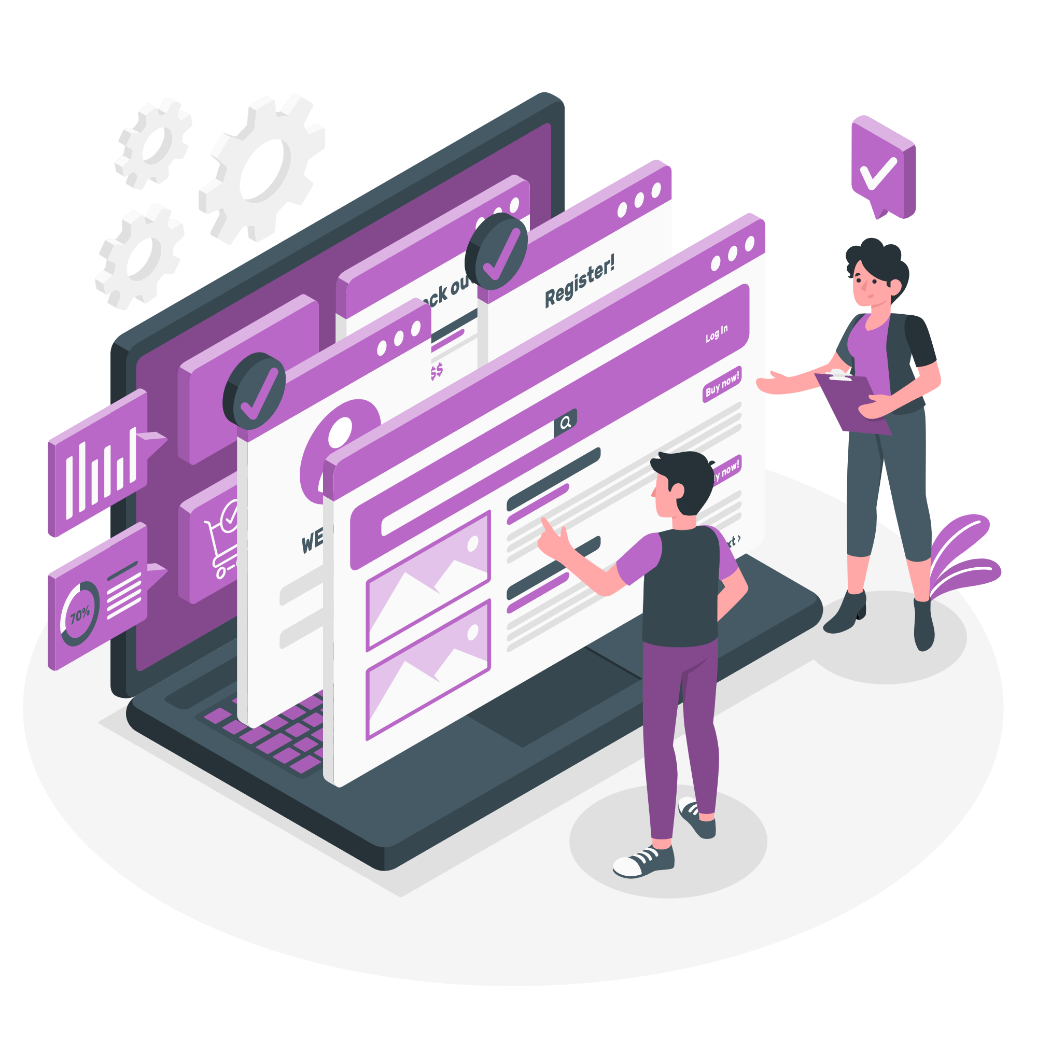
Feedback incorporation

Slide 5

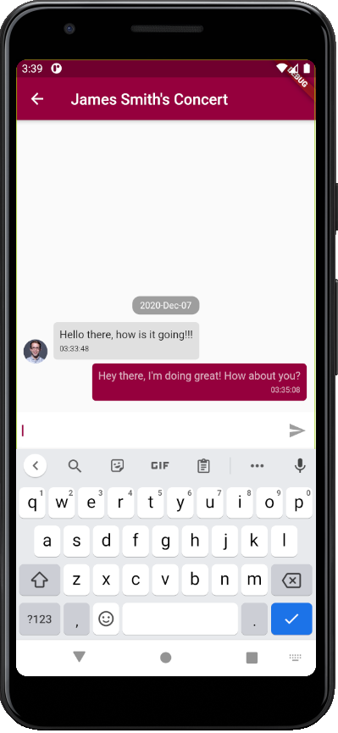
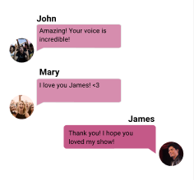
Re-Design
Feedback: Messages sent by the user are not easily distinguished from the messages sent by other fans.
Incorporation

Slide 6
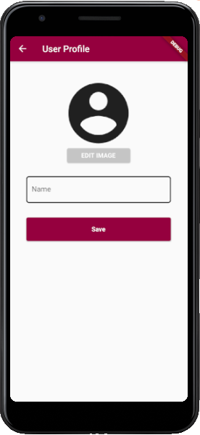
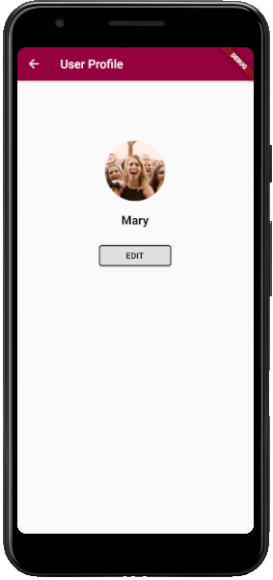
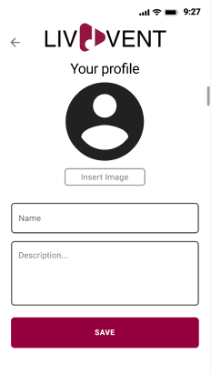
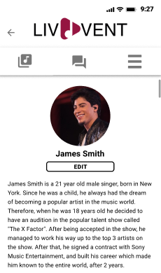
Re-design
Feedback: There could be a profile for music fans as well.
Incorporation

Slide 7


Fully functional prototype

Slide 8
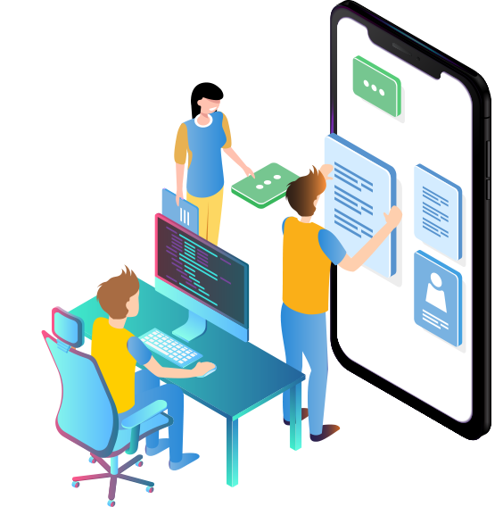

Next steps
Prepare final presentation, including the video.
Continue the development of our fully functional prototype, so it supports all the tasks that were mentioned in previous stages of the development process.

